Slide 1


ANATOMY OF A RÉSUMÉ
A résumé usually has these 5 Sections:
1. Contact Information
2. Professional Summary/Objective/Career Profile
3. Employment History
4. Educational Background
5. Other Skills, Non-Work Experience, and References

Slide 2
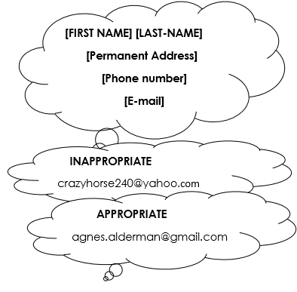
SECTION 1: Contact Information
Things to consider:
• Name should be written in a large bold font
• Use a permanent address that can reliably receive mail.
• Use an appropriate personal e-mail address.

Slide 3
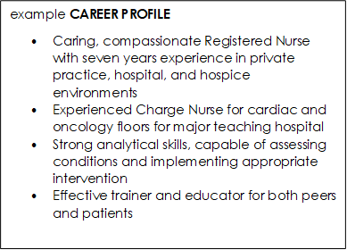

SECTION 2: Professional Summary
A professional summary has these features:
• about 3~4 sentences
• written in the third-person without “I” or “[your name]”
• uses adjectives, verbs, and other focused keywords that “match” qualifications for the position.
• describes the scope of roles, responsibilities, achievements, career highlights

Slide 4
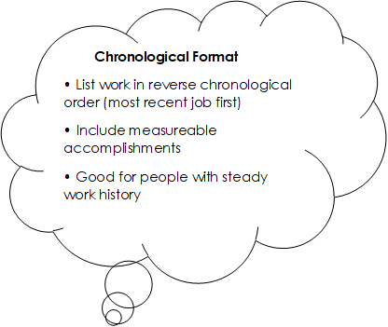
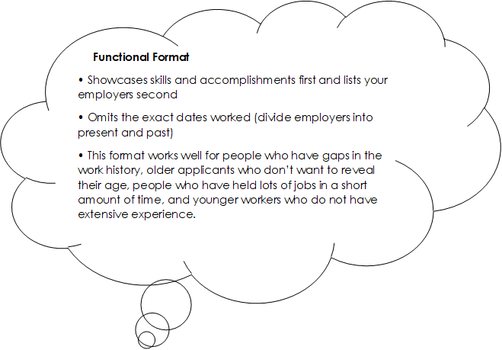

SECTION 3: Work History
Previous/Current Employer Names
Dates worked (optional)
Locations
Job Titles
Responsibilities, skills gained, achievements

Slide 5
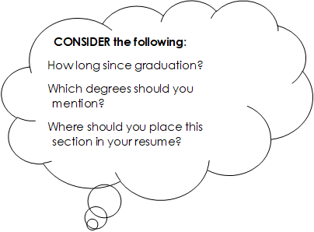

SECTION 4: Educational Background
School Name, Location
Degree Earned, Graduation Date
Honors, Accomplishments, Relevant Coursework (optional)

Slide 6
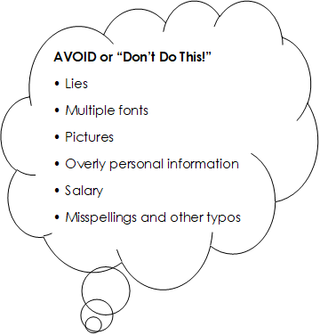

SECTION 5: Other Skills, Non-Work Experience, References
Other Skills
• Languages (level of fluency)
• Computer and other technical skills
(typing speed, Microsoft Office, Operating Systems,
industry-specific software, computer languages)
• Professional associations
Non-Work Experience
• Volunteer service
• Way to demonstrate skills not listed in work experience

Slide 7
