Slide 1
Administrative Assistant

Slide 2
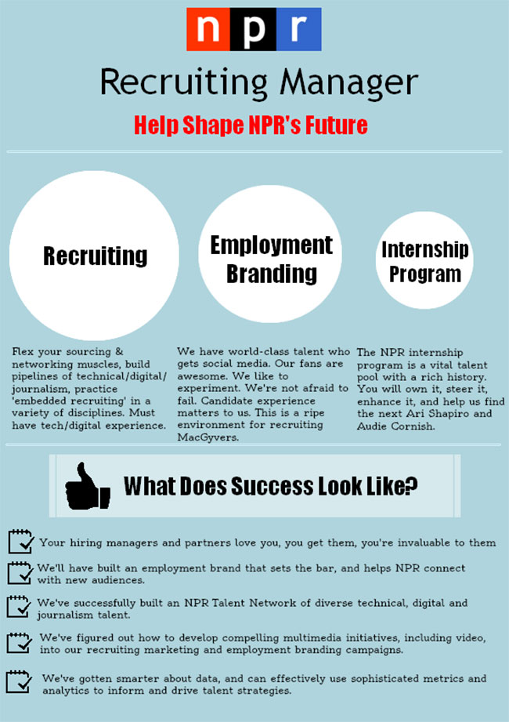
Where do companies advertise jobs?
How do they search for candidate employees?

Slide 3
Local Press
Job centers
Social Media, paid or unpaid
Your website
Recruiters
LinkedIn
External websites
Newsletters
Ask Your Team
Your own reject pile
Industry Blogs
Ask your customers
Job referrals

Slide 4
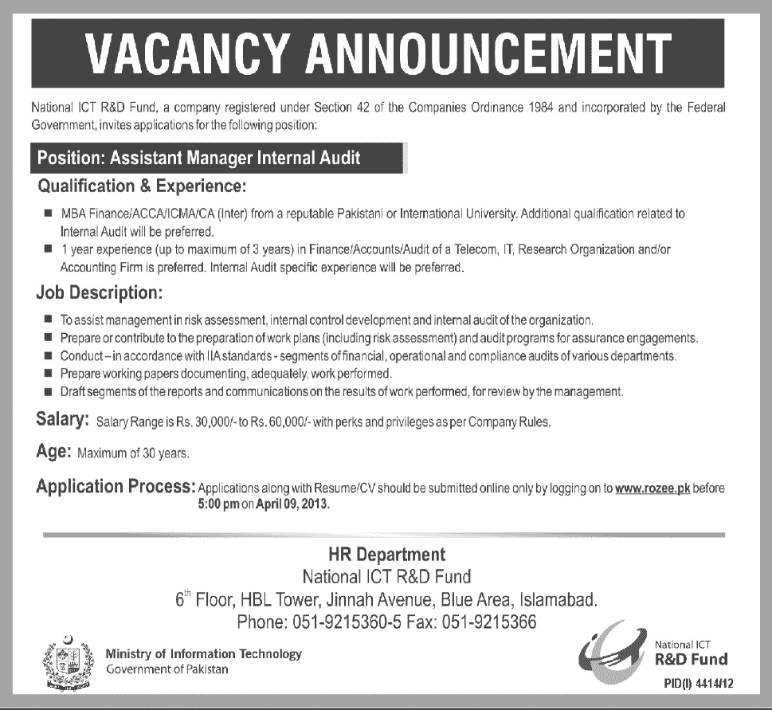
What information is included in a job advertisement?
General Description
Duties
Knowledge, Skills, and Abilities
Education and Experience Requirements
Starting Salary Range
Application Instructions
https://www.thebalancecareers.com/what-information-is-included-on-a-job-posting-1669554

Slide 5
Here is a job advertisement. It comes from an online recruitment site.

Slide 6
Job Reference Number: RY08/364
Administrative Assistant
30 K p.a. plus 25 days vacation and pension plan.
42 hours per week approx. Starting ASAP.
This is a great opportunity to join a busy and established business. Our client is a large manufacturing firm based in southwest Chicago, who is looking for an admin. assistant to help in the running of its busy office.
Duties will include:
Answering the telephone, transferring calls and taking messages
Managing stock and stationery
Filing documents and maintaining the filing system
Audio/copy typing
Making travel and accommodation arrangements
Arranging meetings and diary management
Essential:
A typing speed of at least 50 wpm
Ability to work to deadlines
Good IT skills esp. in word processing and spreadsheets
Desirable:
1 yrs admin experience desirable
Exp. in taking meeting minutes and dictation
We are looking for a good communicator with excellent attention to detail, a positive attitude and an organized approach. The candidate should have the ability to work both in a team and on his/her own initiative. Experience within manufacturing environment would be beneficial to your application.
To apply, please email your CV and a cover letter to Helen Walker at S.T. Recruitment.

Slide 7
Job Reference Number: RY08/364
Administrative Assistant
30 K p.a. plus 25 days vacation and pension plan.
42 hours per week approx. Starting ASAP.
This is a great opportunity to join a busy and established business. Our client is a large manufacturing firm based in southwest Chicago, who is looking for an admin. assistant to help in the running of its busy office.
Duties will include:
Answering the telephone, transferring calls and taking messages
Managing stock and stationery
Filing documents and maintaining the filing system
Audio/copy typing
Making travel and accommodation arrangements
Arranging meetings and diary management
Essential:
A typing speed of at least 50 wpm
Ability to work to deadlines
Good IT skills esp. in word processing and spreadsheets
Desirable:
1 yrs admin experience desirable
Exp. in taking meeting minutes and dictation
We are looking for a good communicator with excellent attention to detail, a positive attitude and an organized approach. The candidate should have the ability to work both in a team and on his/her own initiative. Experience within manufacturing environment would be beneficial to your application.
To apply, please email your CV and a cover letter to Helen Walker at S.T. Recruitment.
What information do you get from this ad?
Job Title
Salary
Hours per week
Benefits
Location
Application Procedure

Slide 8
Job Reference Number: RY08/364
Administrative Assistant
Do you know what these abbreviations stand for?
K?
thousand
p.a.?
per annum
esp.?
especially
exp.?
experience
yrs?
years
IT?
Information Technology
wpm?
words per minute
approx?
approximately
ASAP
as soon as possible
30 K p.a. plus 25 days vacation and pension plan.
42 hours per week approx. Starting ASAP.
This is a great opportunity to join a busy and established business. Our client is a large manufacturing firm based in southwest Chicago, who is looking for an admin. assistant to help in the running of its busy office.
Duties will include:
Answering the telephone, transferring calls and taking messages
Managing stock and stationery
Filing documents and maintaining the filing system
Audio/copy typing
Making travel and accommodation arrangements
Arranging meetings and diary management
Essential:
A typing speed of at least 50 wpm
Ability to work to deadlines
Good IT skills esp. in word processing and spreadsheets
Desirable:
1 yrs admin experience desirable
Exp. in taking meeting minutes and dictation
We are looking for a good communicator with excellent attention to detail, a positive attitude and an organized approach. The candidate should have the ability to work both in a team and on his/her own initiative. Experience within manufacturing environment would be beneficial to your application.
To apply, please email your CV and a cover letter to Helen Walker at S.T. Recruitment.

Slide 9
To find the right "fit" of employee, companies must have a people-focused culture
and
human resource hiring strategy
that focuses on finding and developing successful employees who meet company goals.
The disconnect comes when the company's business strategies, company culture, and HR activities are not aligned.

Slide 10
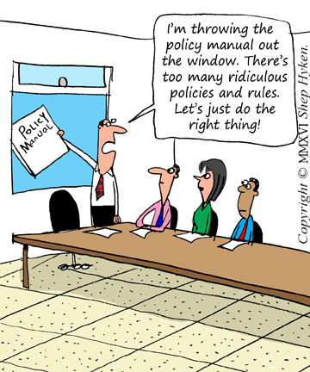
A working people-focused culture means that the employees there are all authentic with their service, and they were hired because of it.
Sincere greetings, genuine smiles and eye contact are some of the secrets.
A café owner looking for someone who looks him in the eye when they talk, has a pleasant demeanor and upbeat personality, as well as a care about their physical appearance, believes that it is worth more to him than any experience on their resume. This owner clearly has mastered the art of good hiring.

Slide 11
Hard skills and soft skills

Slide 13
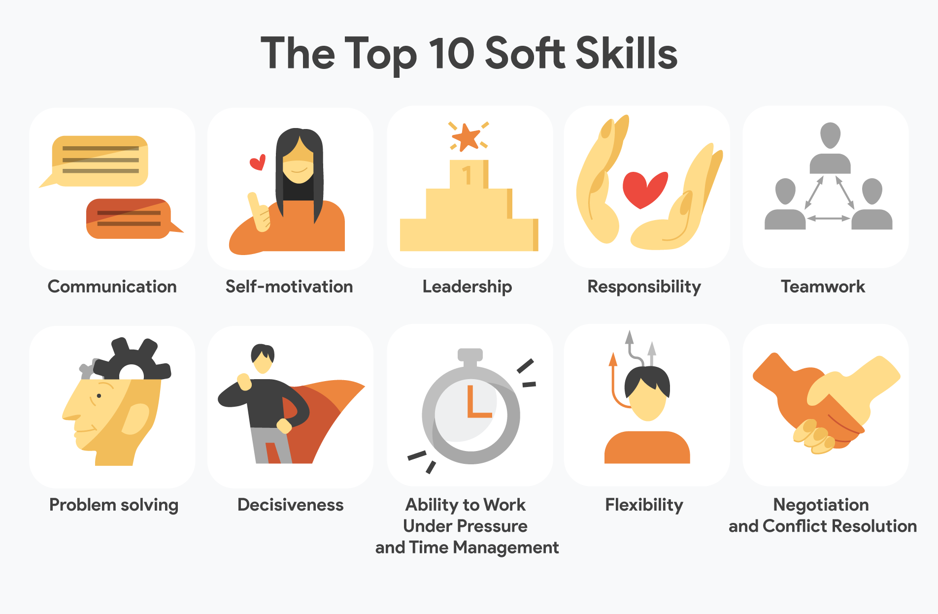

Slide 15
Job qualities
“ They’re looking for someone who’s well rounded and knows how to keep a cool head”.
https://www.youtube.com/watch?v=9nBgcoZBuiQ

Slide 16
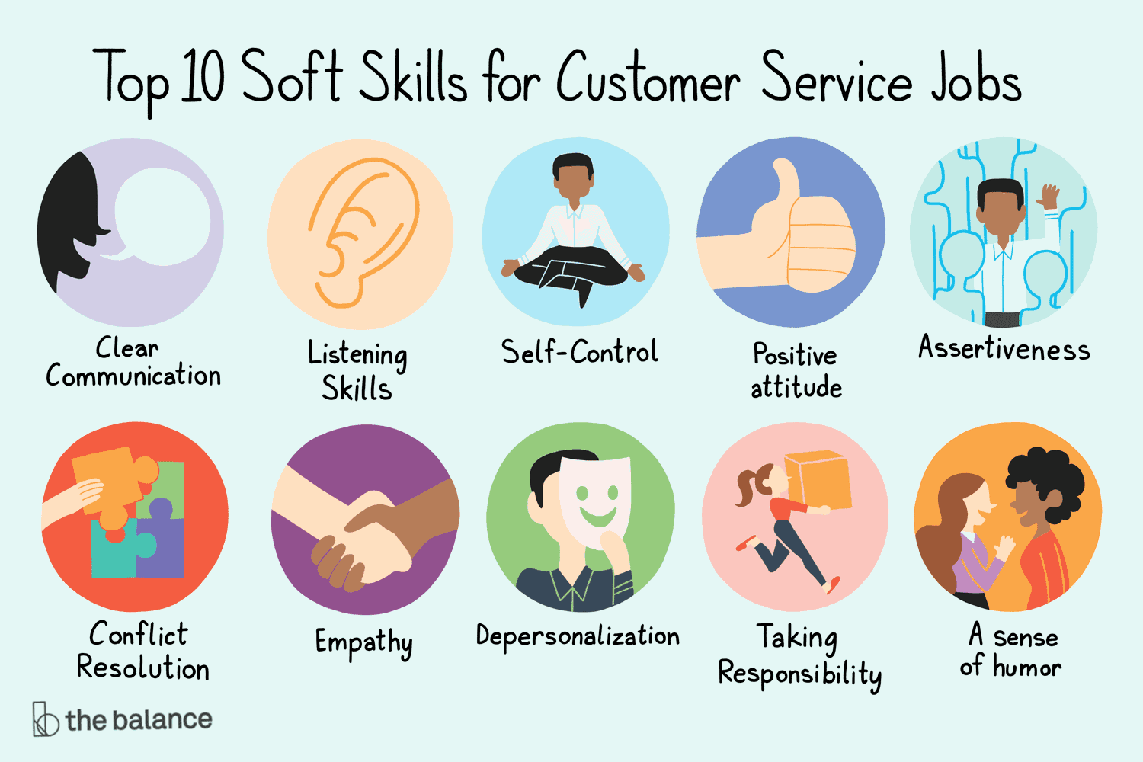

Slide 17
Top 10 Soft Skills for Customer Service Jobs
Communication ~ Clear communication is essential in customer service. Do they have an upbeat and easy to understand communication style? These skills are essential in phone communication as well.
Listening ~ Listening skills are just as important as communication skills. Do they demonstrate that they are listening through body language and responses such as nodding and making eye contact, etc. An important aspect of customer service is simply making the customer feel heard.
Self-Control ~ People that work in customer service need to be able to calmly handle all customers, even the most negative ones.
Positivity ~ A positive attitude goes a long way in customer service. Positivity is an easy characteristic to look for in a person.
Assertiveness ~ Do they appear to be a "take control" type of person, doing what needs to be done in an efficient manner? If they are meek or passive, the customer may not have faith in them.
Conflict Resolution ~ In customer service, you deal with many customers who have a problem that needs to be solved. It is important for you to be a creative problem solver.
Empathy ~ A very important soft skill is being able to recognize and understand a person’s emotional state, how they feel, and react with empathy.
Depersonalization ~ Customers want to feel understood and appreciated. A simple “I understand” or “I know how you feel” will keep the focus on them.
Taking Responsibility ~ Do you feel they will be able to sincerely apologize to a customer on behalf of your company, even when the problem was not their fault?.
Humor ~ A sense of humor can make a potentially stressful customer-service interaction more enjoyable. Crack a silly joke, and see if they laugh with you and join in with humor.

Slide 18
How to sound business-like
Watch this video:
https://www.youtube.com/watch?v=_2ZDNgtAsbw

Slide 19
How to sound business-like
I got your email - I r_____________ your email
I need some help - I r________ some a___________
Let’s talk about it later - Let’s d____________ it later
How do I get in touch with her? - How do I c_________ her?
Make sure you arrive on time - Please e__________ that you arrive on time
Give her your travel plans - Please p__________ her with your i_____________
Let them know - Please i__________ them
Tell me why you made this decision – Please e___________ why you made that decision
Could you please talk some more about that subject? - Could you please e____________ on that subject?
Please fix the problem – Please s________ the problem

Slide 20
Dealing with complaints
Watch this video:
https://www.youtube.com/watch?v=T20hV4ynU7o

Slide 21
LinkedIn is a social network that focuses on professional networking and career development.
You can use LinkedIn to display your resume, search for jobs, and enhance your professional reputation by posting updates and interacting with other people.
LinkedIn is free, but a subscription version called LinkedIn Premium offers additional features like online classes and seminars, as well as insights into who's searching for and viewing your profile.
Its headquarters are in the Silicon Valley

