Slide 1
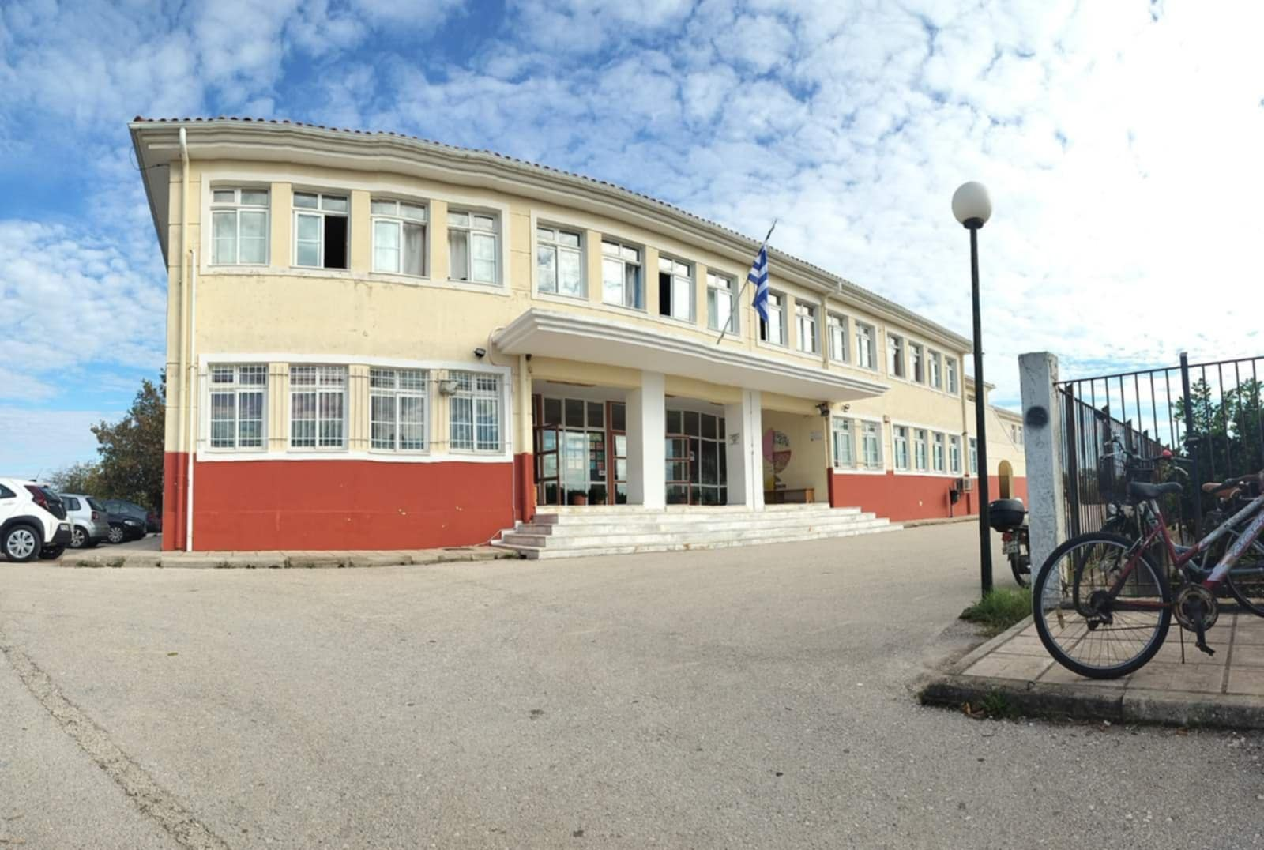
Our School
This is our school, the 4th Junior high school of Preveza

Slide 2
The school was relocated in 2006 to a newly built modern building where classes are still held today.
It is well equipped with general education classrooms, physics-chemistry, computer, technology, art and music laboratories with appropriate and functional spaces, in very good condition and sufficient for the implementation of the school program.

Slide 3
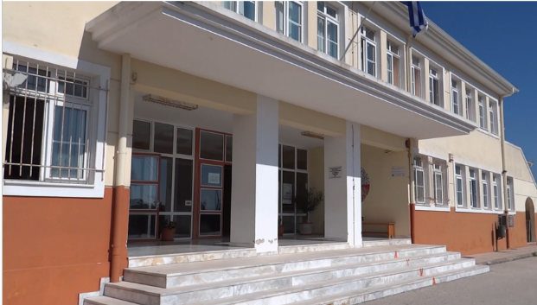
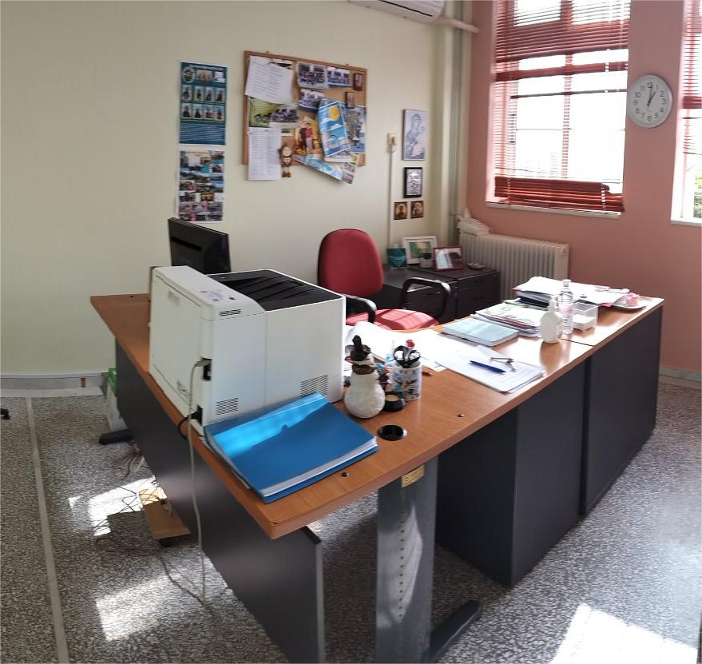
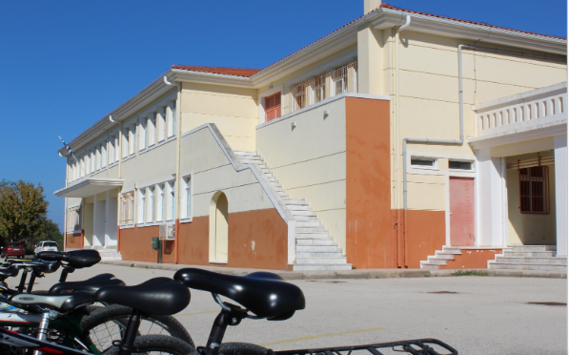

Slide 4
9 Classrooms equipped with wifi, and electrical equipment for computers and interactive whiteboards

Slide 5
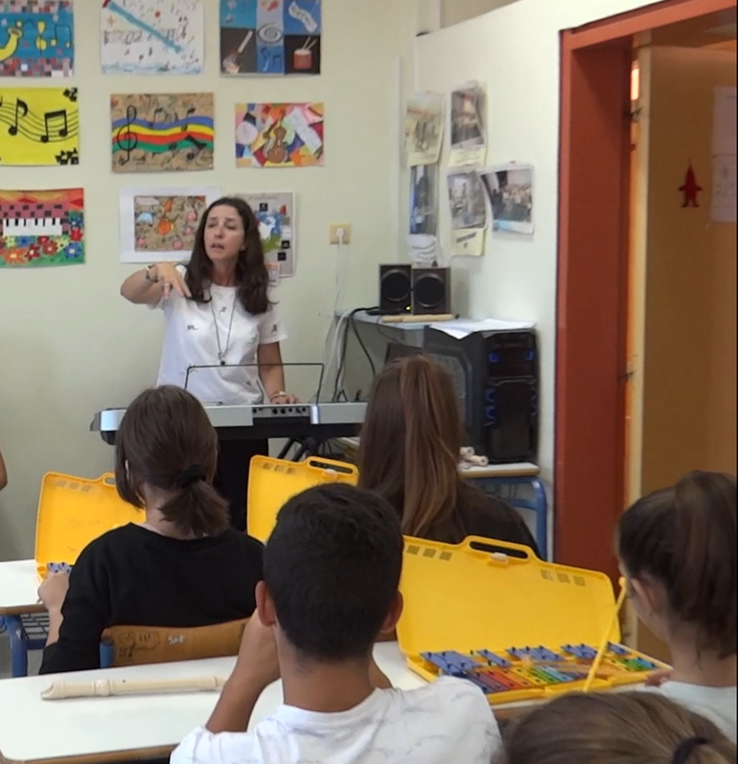
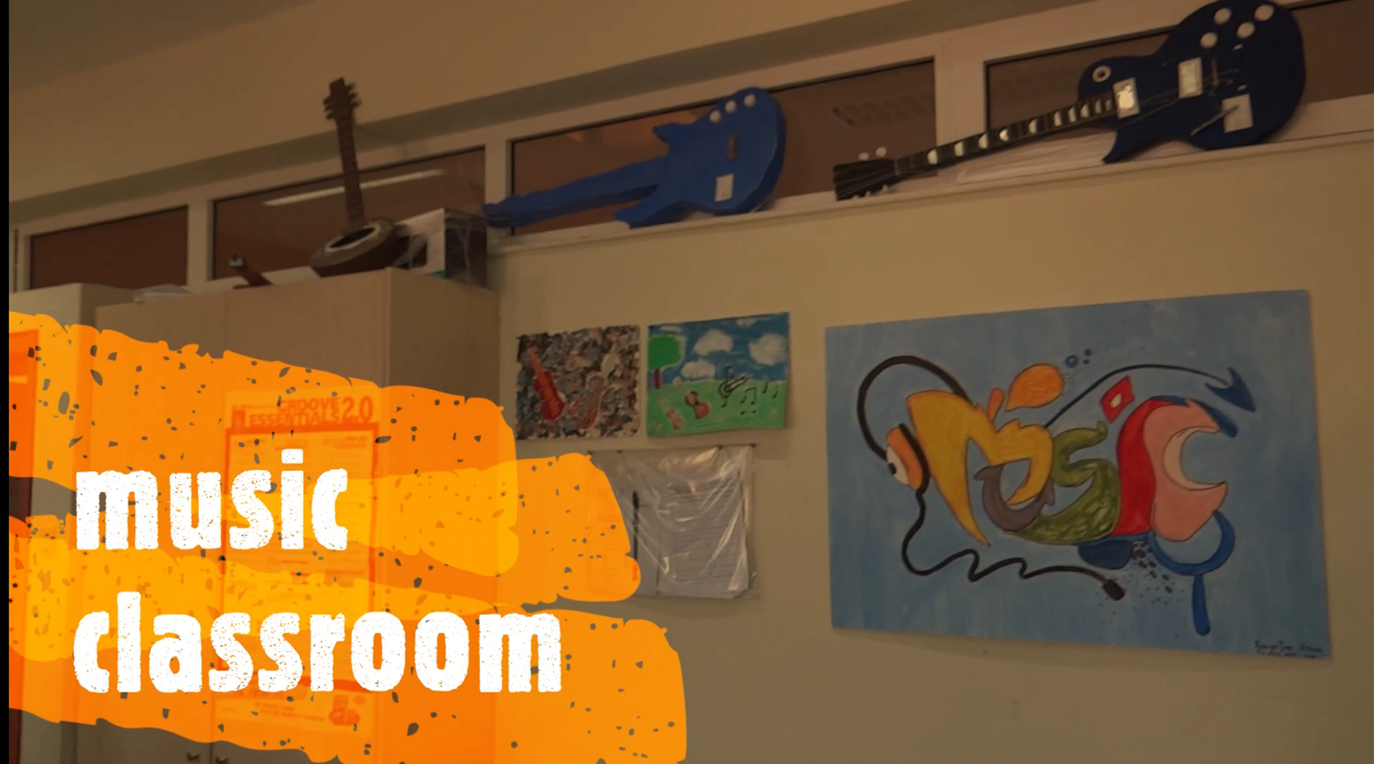
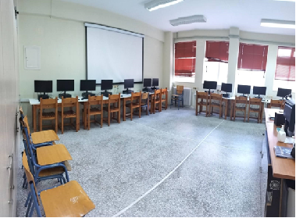
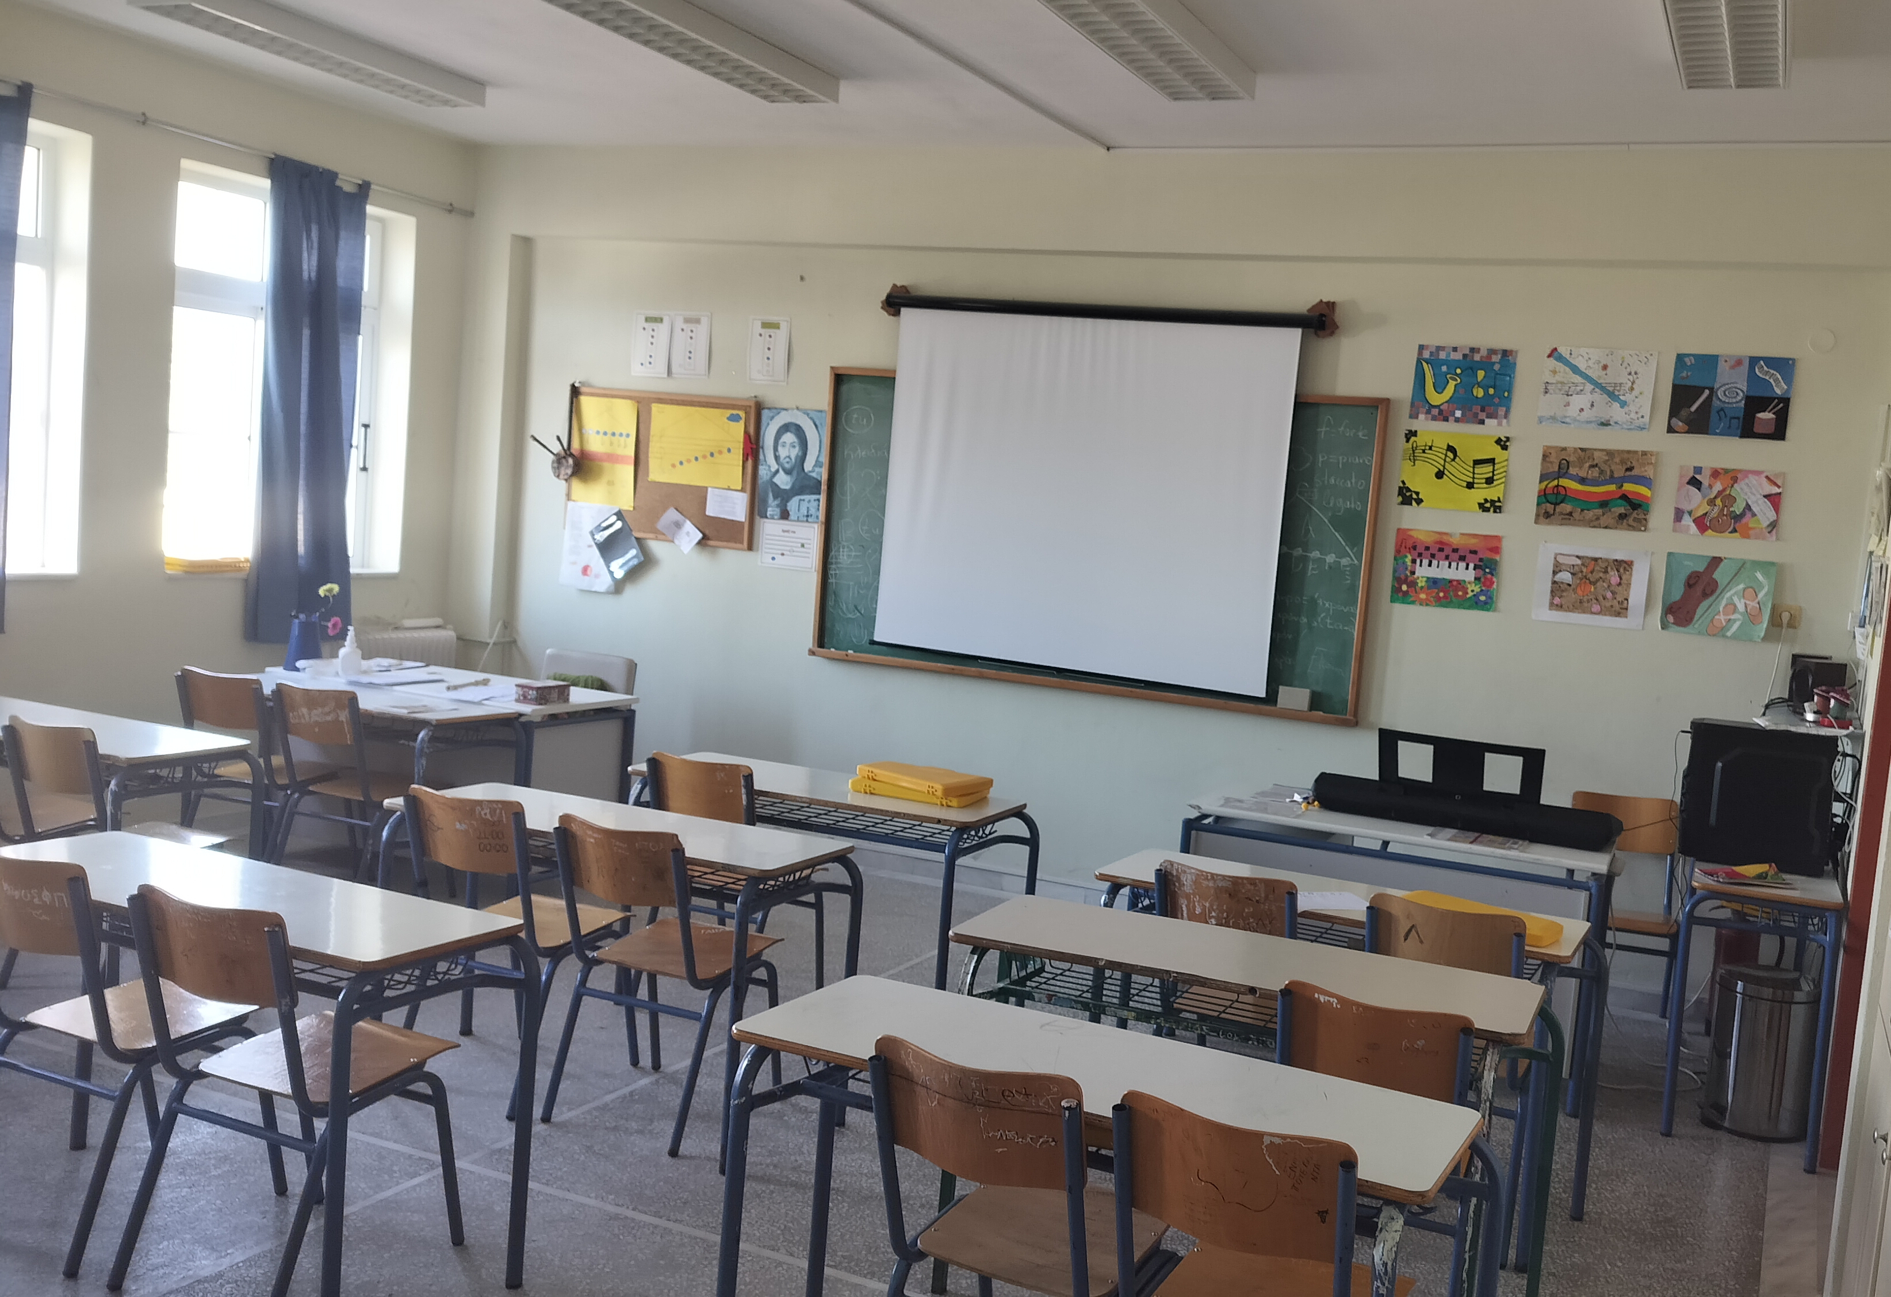
LABORATORIES
Computers’ Laboratory: Equipped with a modern set of computers - 12 in number - Projector and projection screen, server and 1 more computer
Music Laboratory: Equipped with a computer and musical instruments such as piano, drams, flutes, metallophones

Slide 6
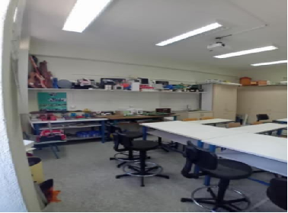
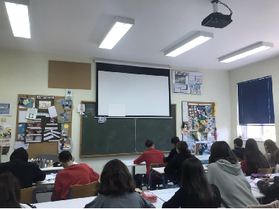
LABORATORIES
Technology Laboratory: Equipped with a computer, a projector, a projection screen, a colour printer and many constructions by the pupils after they completed their projects.
Art Laboratory: Equipped with a computer, a projector and many paintings and Artwork produced by the pupils.

Slide 7
►Science Laboratory: Equipped with a modern interactive system and PC, Projector, projection screen and stuff and equipment needed for Chemistry experiments.

Slide 8
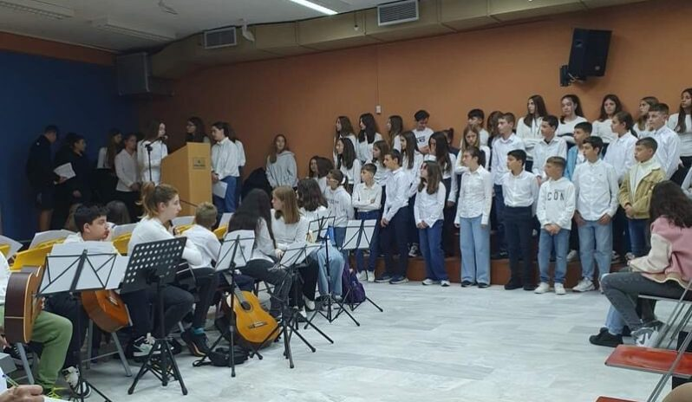
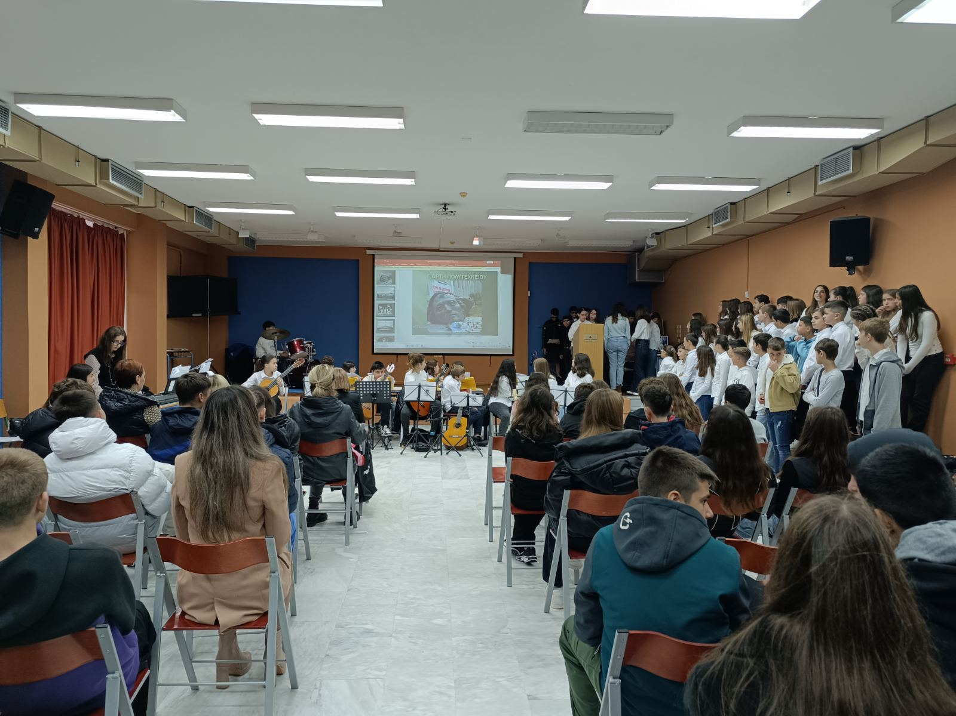
ASSEMBLY HALL with central microphone installation, a PC, a projector and a projection screen, as well as a stage for school performances

Slide 9
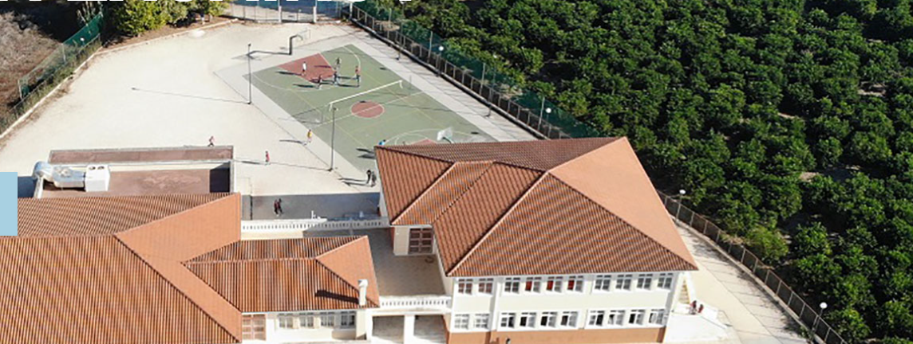
Large courtyard space, with benches and trees combined with the beautiful natural environment meet the needs of students and teachers. We also have a basketball and volleyball court.

Slide 10
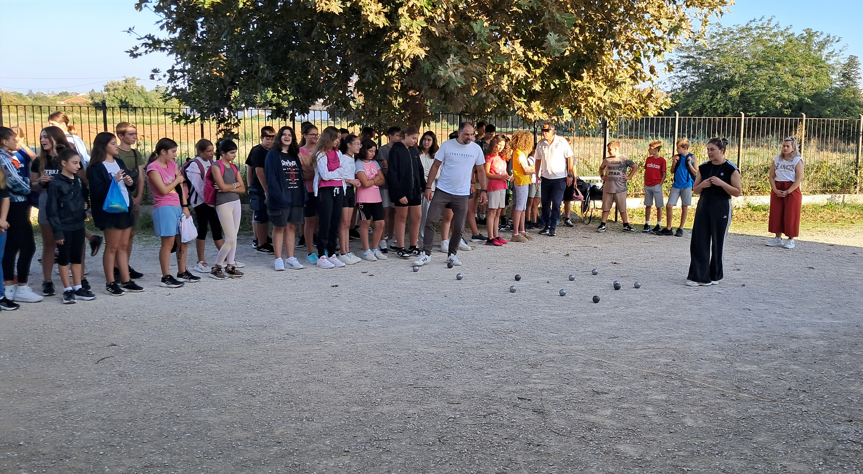
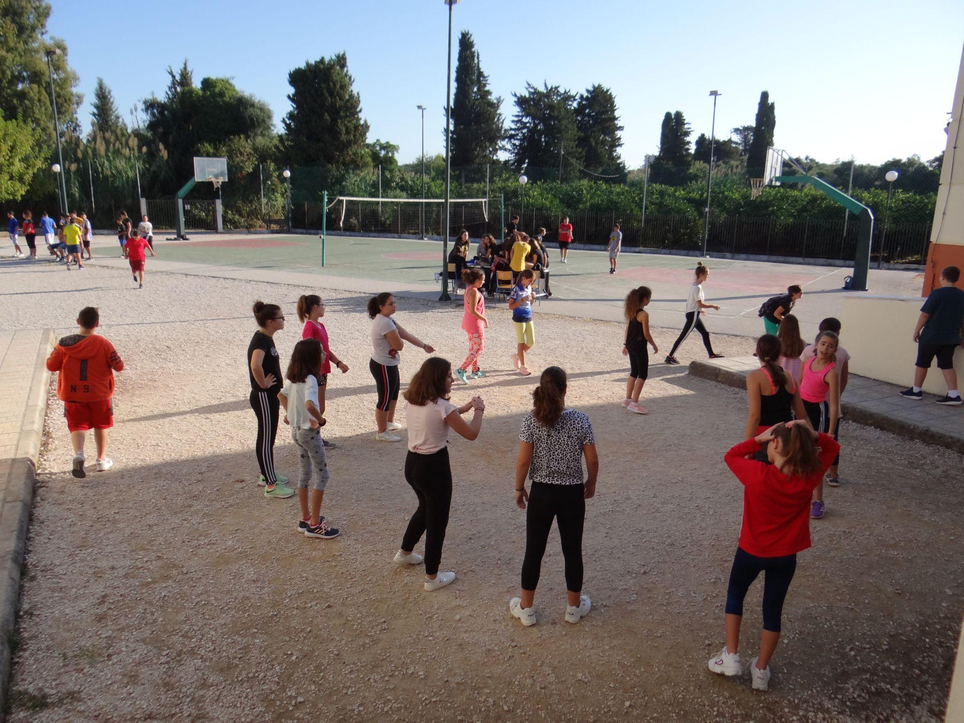
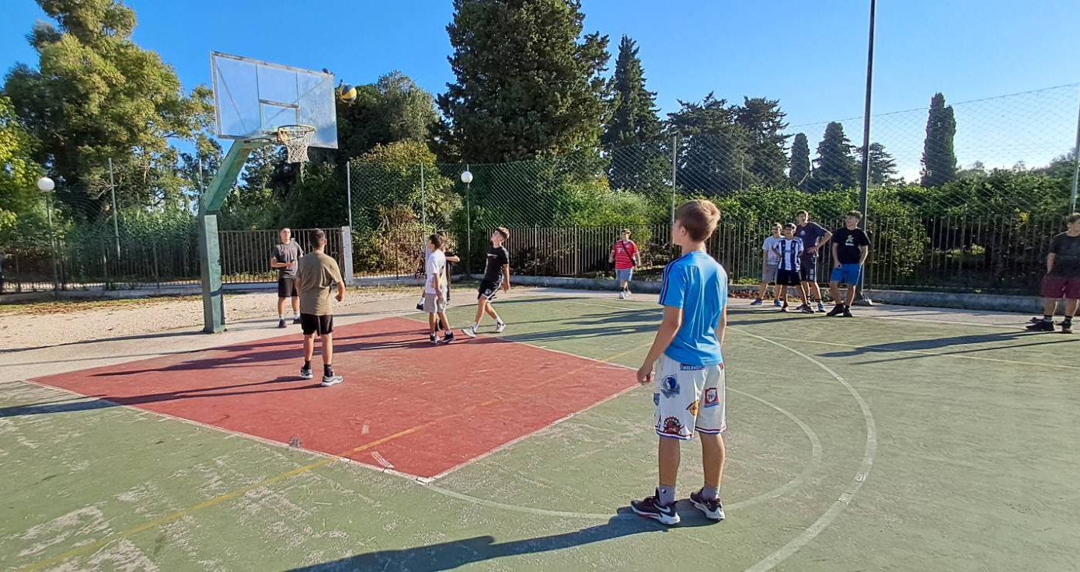
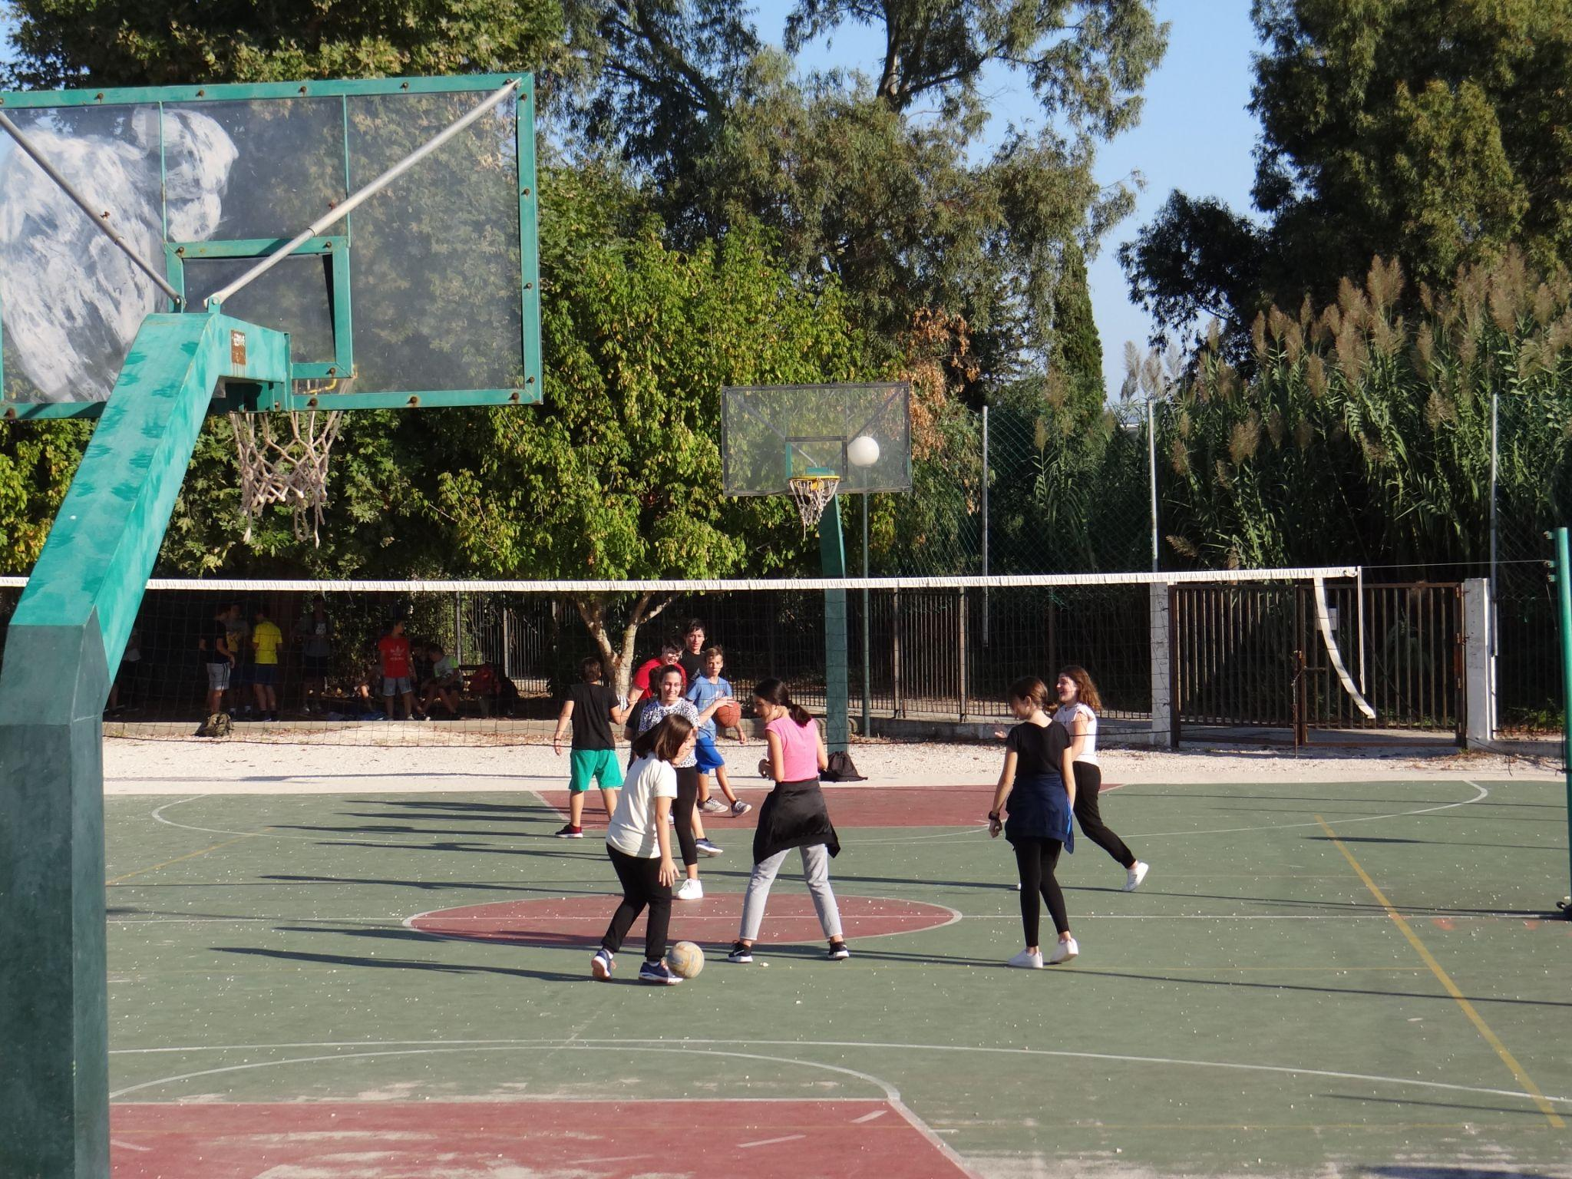
Sports Activities

Slide 11
Our teachers
2 Math teachers
1 Information Technology teacher
1 Religion education teacher
2 Natural Science teachers (Biology, Chemistry, Physics)
2 English teachers
1 P. E. teacher
8 Modern/Ancient Greek, Language and History teachers
2 German teachers and 2 French teachers
1 Music teacher
1 Art teacher
1 teacher for Social & Political education and Home Economics
1 teacher for Technology

Slide 12
Our Educational System
Primary School
6 grades
Senior High School
3 grades
Junior High School
3 grades

Slide 13
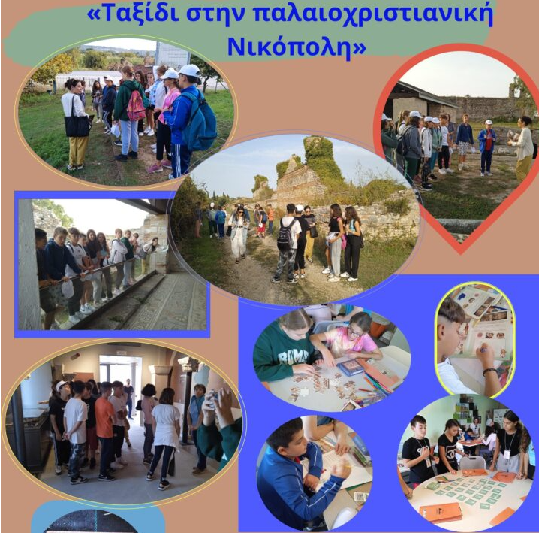

Slide 14
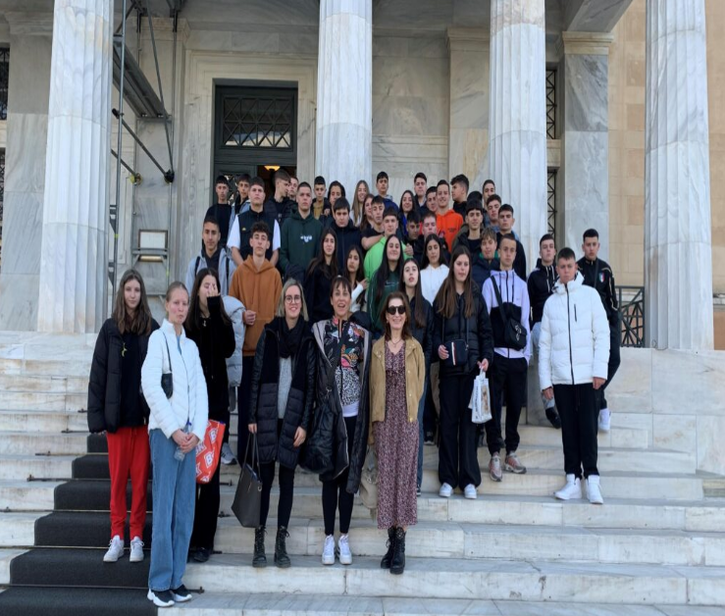
School activities and other projects

Slide 15
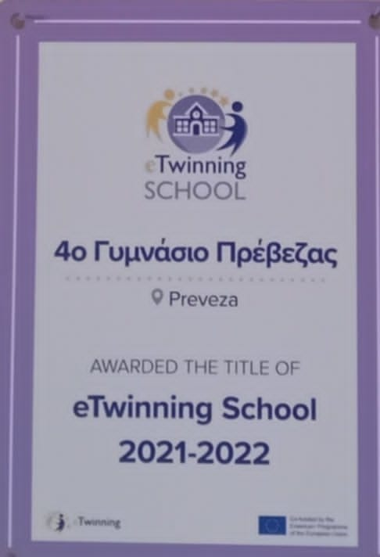
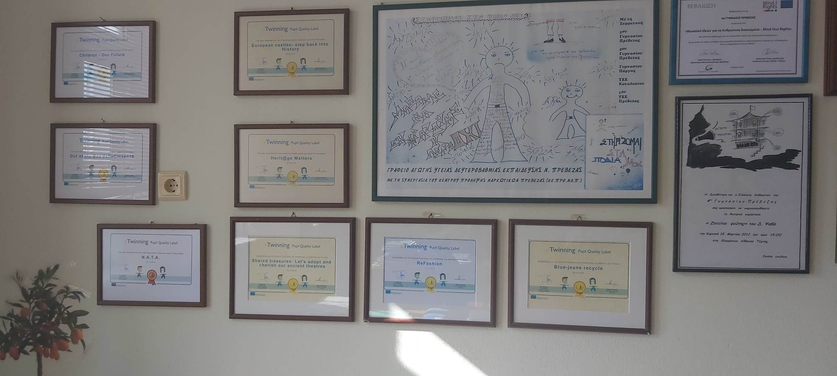
Our school participates in many European programs - Erasmus+, Etwinning - and has carried out many actions aimed at highlighting important values ​​of the European Union.

Slide 16
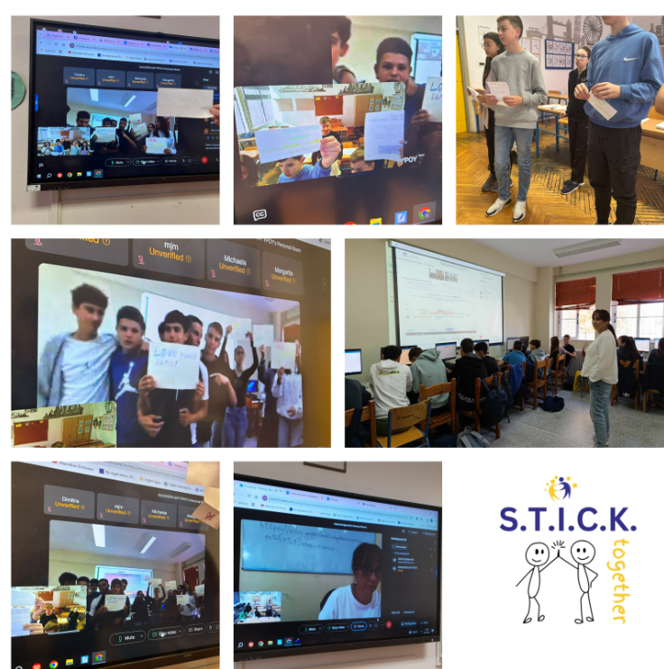
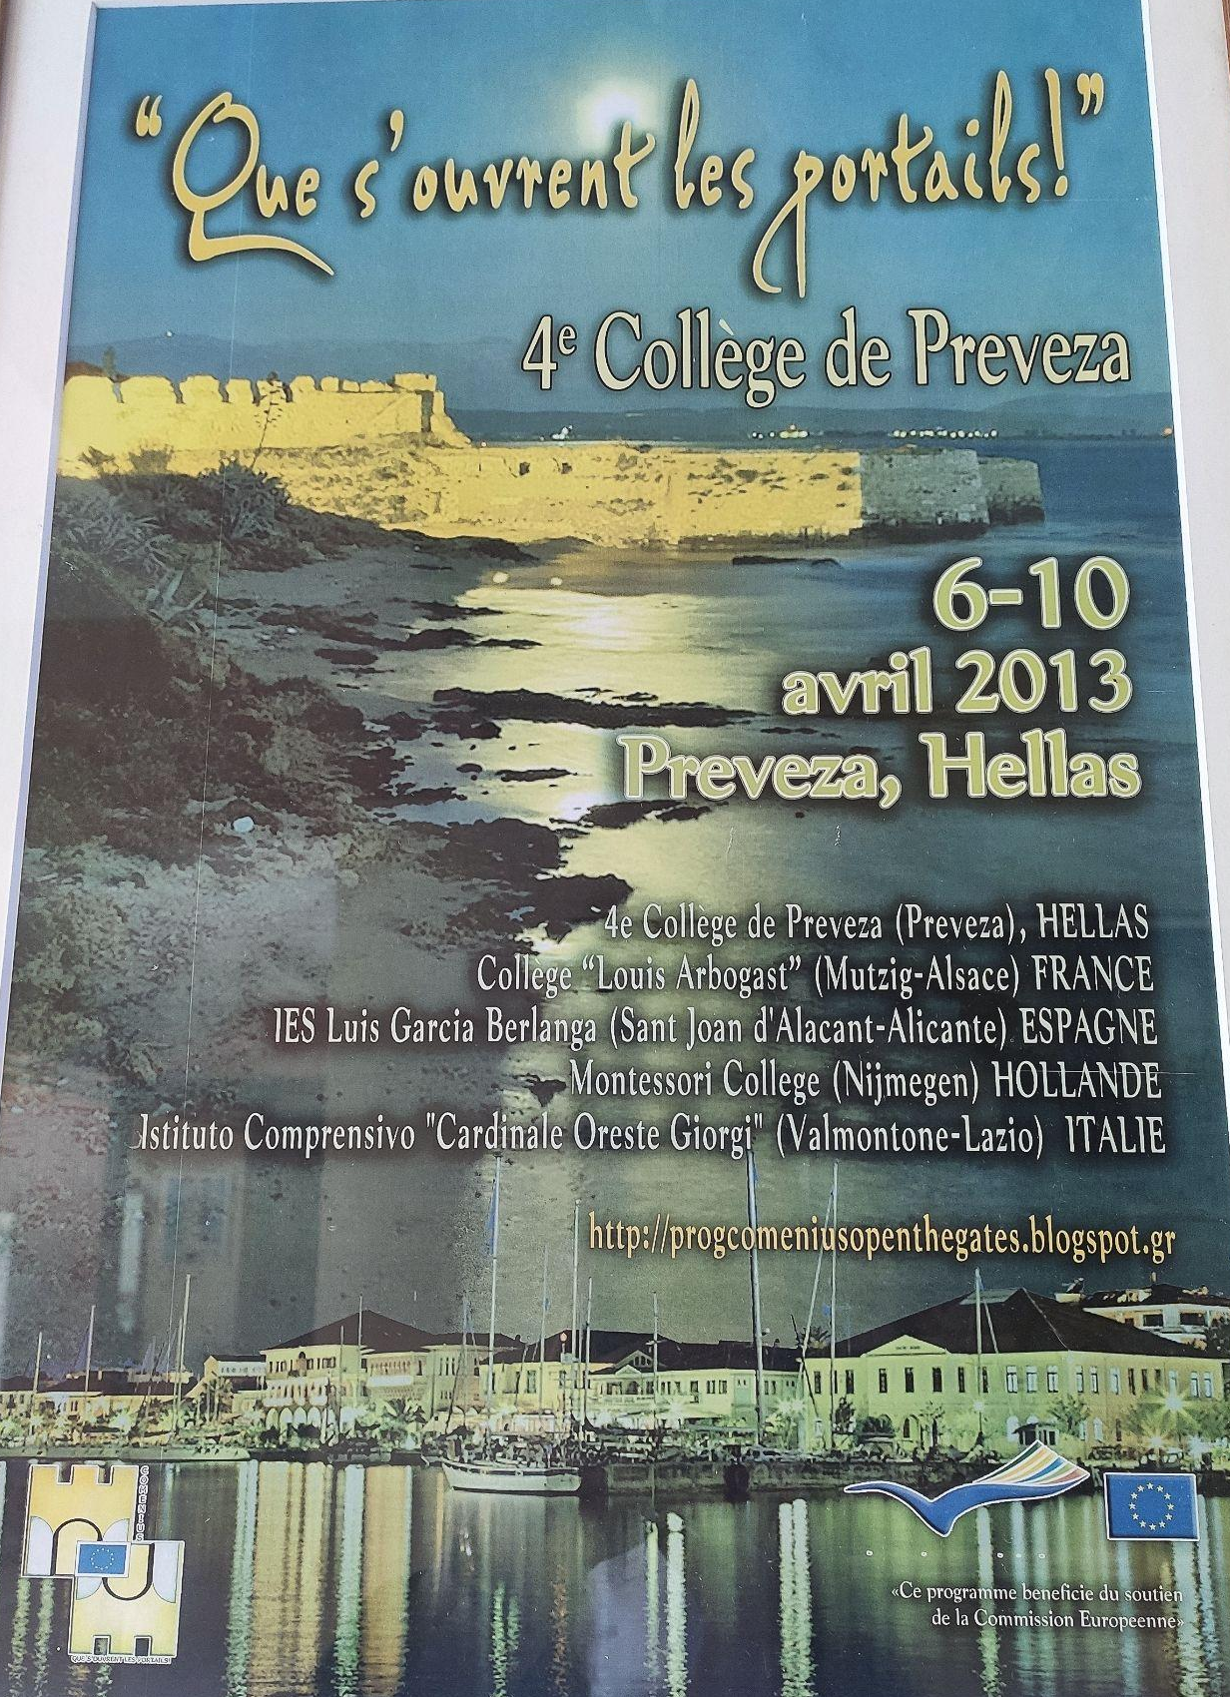
Erasmus+, Etwinning projects

Slide 17
Posters created after translational meetings
in other European countries

Slide 18
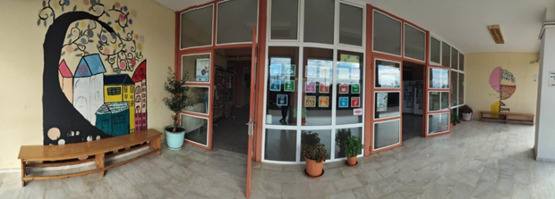
4th Junior High uuSchool of Preveza
WEB site : http://mail@4gym-prevez.pre.sch.gr/
e-mail : mail4gym@prevez.pre.sch.gr
https://www.facebook.com/groups/1273065696953504/

Slide 19
Thank you ! ! !
We are expecting you there in April ! !

