Slide 1
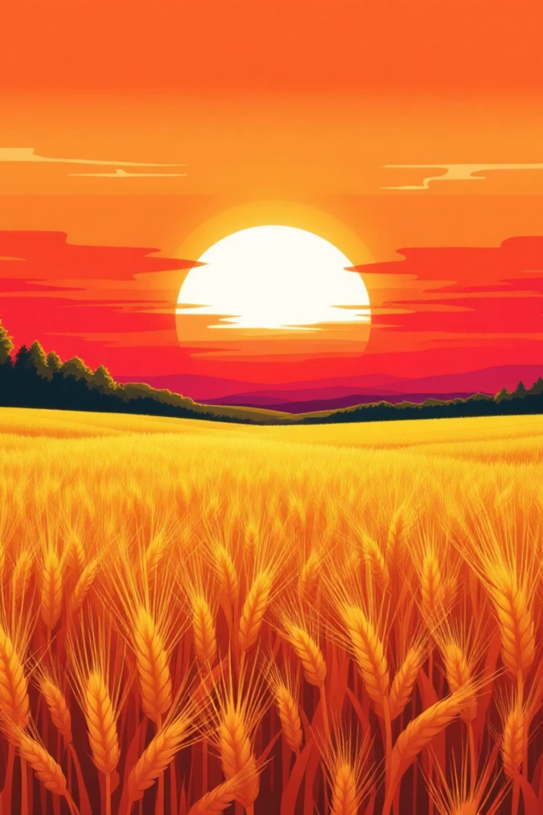
Field Crops: Our Basic Source of Food 🌾
Welcome, future farmers! Today we'll explore how plants feed the world and help farms thrive. Let's discover the amazing world of field crops together.

Slide 2
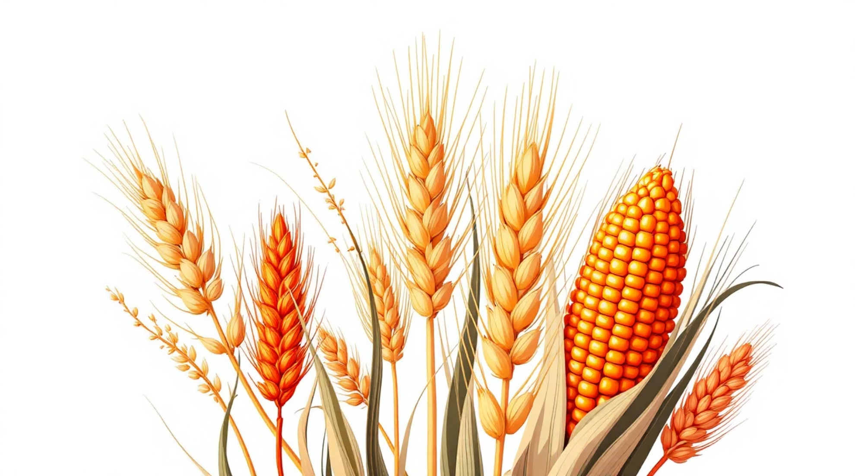
Cereals (Grains) 🌾
What Are Cereals?
The basic source of food for humans and animals worldwide.
Life Cycle
They are Annuals – they live for just one year.
Health Benefits
High in Carbohydrates for energy! 🏃
Wheat
Barley & Rye
Oats
Bread, pasta, and more
Beer and special breads
Porridge and healthy food
Corn 🌽
Rice 🍚
Popcorn, tortillas, feed
Grows in water! Needs flooding

Slide 3
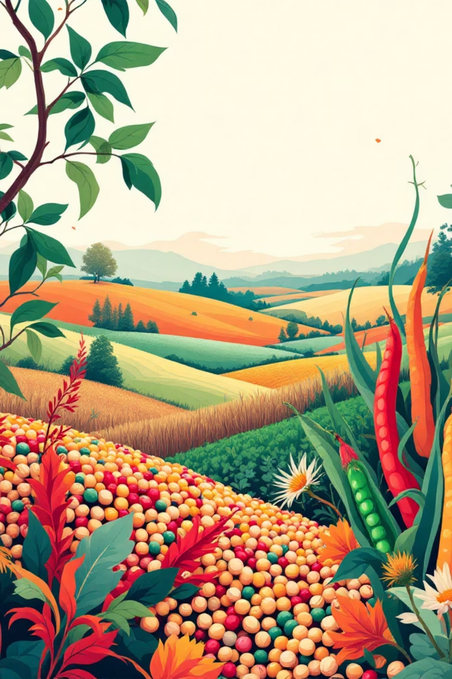
Legumes (Pulses) 🌱
The Soil Superheroes
They enrich the soil for other crops by adding nitrogen naturally. This helps future plants grow strong!
Resilient Plants
They have deep roots that survive drought and tough conditions. Nature's tough guys!
Protein Power 💪
The main source of Protein for muscles and growth. Beans, peas, lentils, and chickpeas are all legumes!

Slide 4
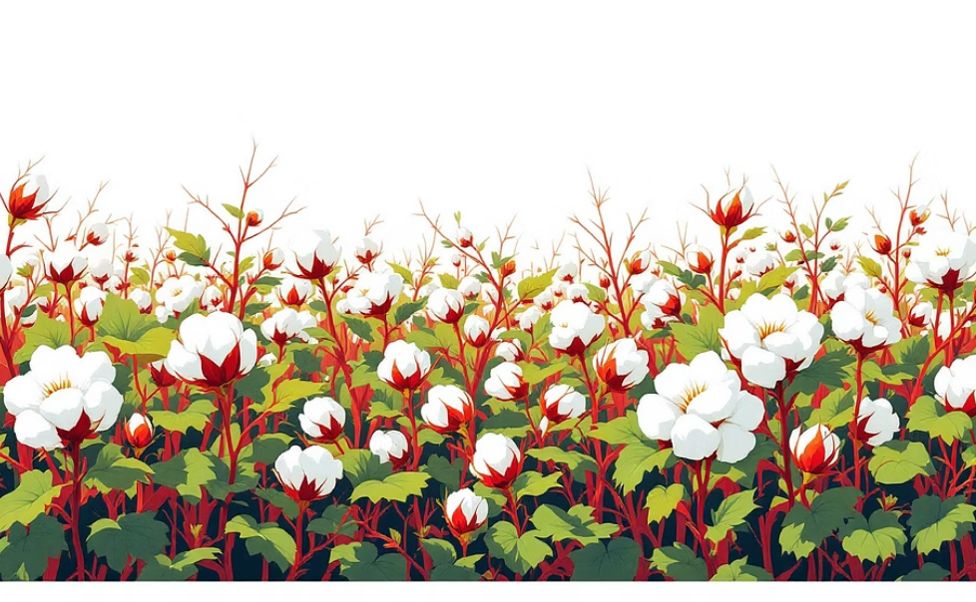
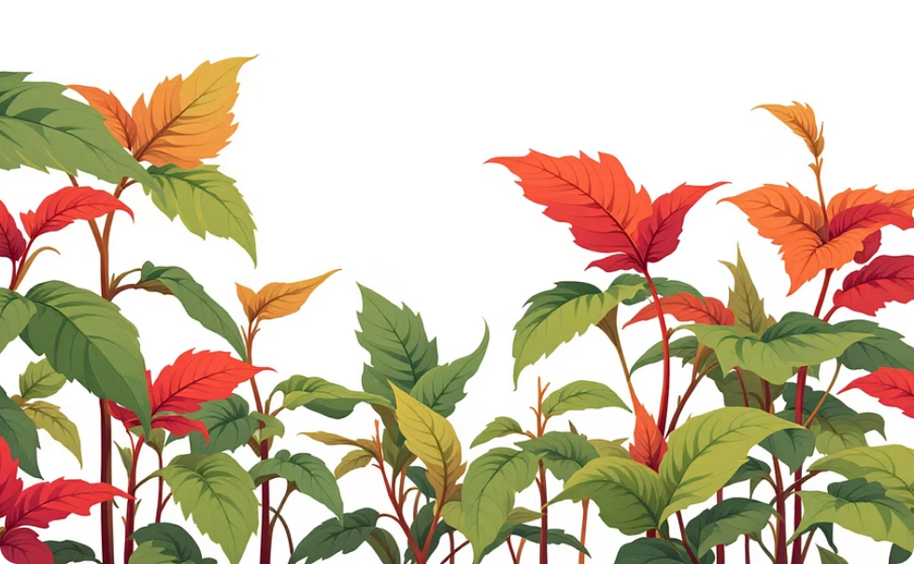
Industrial Crops 🚜
Cotton ☁️
Tobacco 🍂
Soft, white fibers for clothes and textiles.
Grown for commercial use.
Needs irrigation (water)
Requires fertilizers
Needs insecticides protection
Grows as a perennial in the wild
Farmers grow it as an annual
Needs careful cultivation

Slide 5
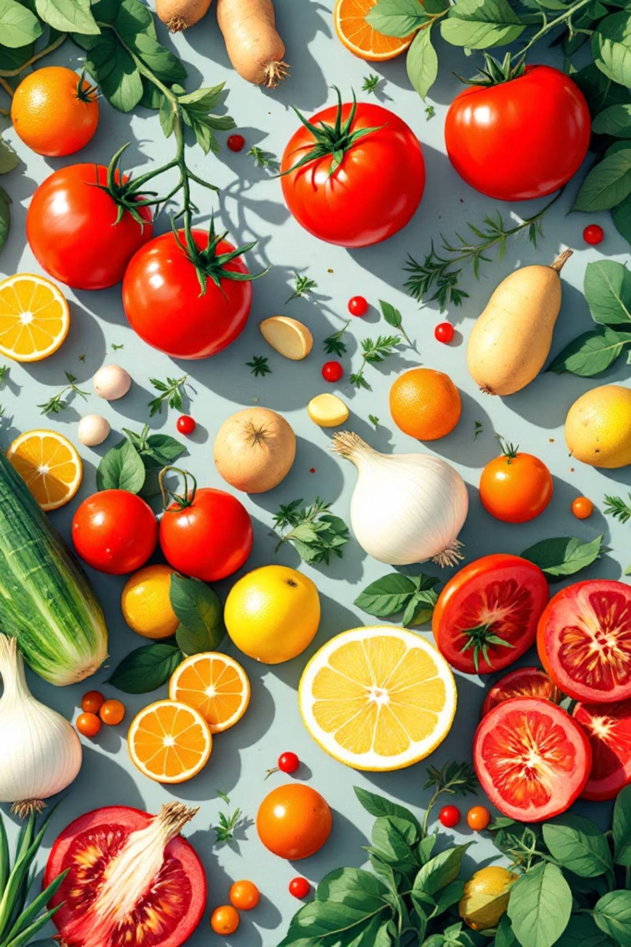

Vegetables & Fruits 🍎
Potatoes 🥔
They are tubers – vegetables that grow underground. Rich in energy and vitamins!
Tomatoes 🍅
Grown in greenhouses 🏠 all year round in Greece and many countries.
Citrus Fruits 🍋
Oranges, lemons, and limes need lots of sunshine and no frost (ice). Tropical sunshine lovers!
Bulbs 🧅
Onions and garlic help our blood circulation ❤️ and keep us healthy.

Slide 6
Activity: The Plant Life Clock ⏳
Can you match each plant to how long it lives?
Annuals (1 Year)
Biennials (2 Years)
Perennials (Many Years)
Cereals (Wheat, Corn)
Cotton
Tomatoes
Onions
Garlic
Leeks
Pasture Grasses
Fruit Trees (Apples)
Citrus Trees

Slide 7




Vocabulary Match-Up 🎮
Can you match the farming words with their meanings?
Irrigation 💧
Giving thirsty plants a drink of water through pipes or sprinklers.
Weeding 🌿
Pulling out the "bad" plants (weeds) that steal nutrients from crops.
Greenhouse 🏠
A glass house that stays warm in winter to grow plants year-round.
Tuber 🥔
A vegetable that hides under the ground, like potatoes and sweet potatoes.

Slide 8
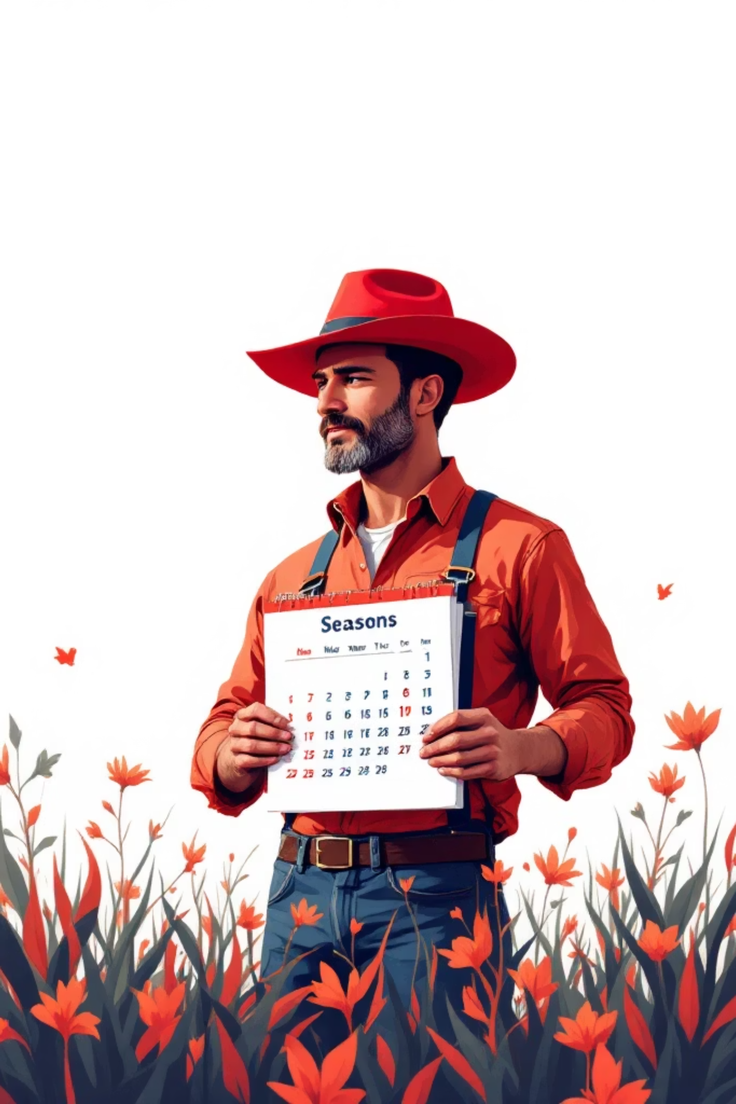
The Farmer's Calendar 📅
1
Winter/Spring
Planting Season
Cereals and Legumes go into the soil. The cold weather helps them start growing strong.
2
Summer
Irrigation Time 💧
Intensive watering for Cotton and thirsty crops. Hot weather needs extra care!
3
All Year
Greenhouse Work 🏠
Using greenhouses to grow vegetables like tomatoes and cucumbers in winter months.

Slide 9
Quick Quiz! 🧠
Fill in the blanks using these words: (Annual, Greenhouse, Protein, Water)
Question 1
Question 2
Rice grows in _________. 🌊
Legumes are a great source of _________. 💪
(Answer: Water)
(Answer: Protein)
Question 3
Question 4
We use a _________ to grow tomatoes in winter. 🏠
A plant that lives for one year is an _________. 🌾
(Answer: Greenhouse)
(Answer: Annual)

Slide 10
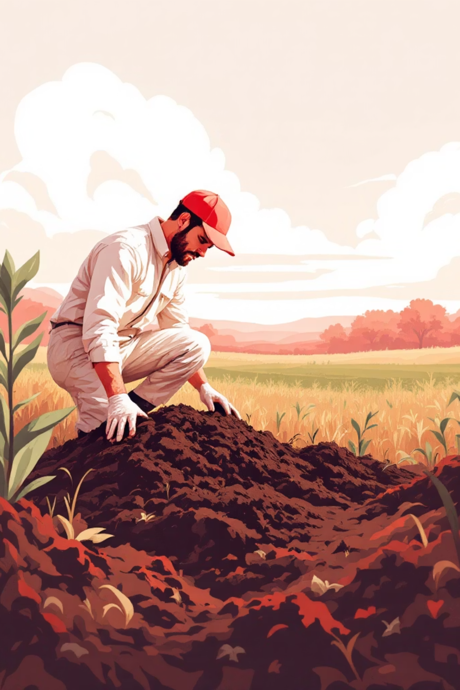

Final Agronomist Challenge 🌟
Critical Thinking Challenge
Question: If a field has "tired" soil (no nutrients), what should a farmer plant to fix it?
A) Corn
A cereal that uses lots of nutrients
B) Beans (Legumes) ✓
The Correct Answer! They enrich the soil with nitrogen
C) Rice
Needs flooded fields, doesn't fix soil
Why B is correct: Legumes are soil superheroes! They add nutrients back into tired soil, preparing it for future crops. This is called crop rotation.

