Slide 1
The Right Holiday!

Slide 2
What can you see?
Where do you think it is?
Would you like to visit it?
Why / Why not?

Slide 3
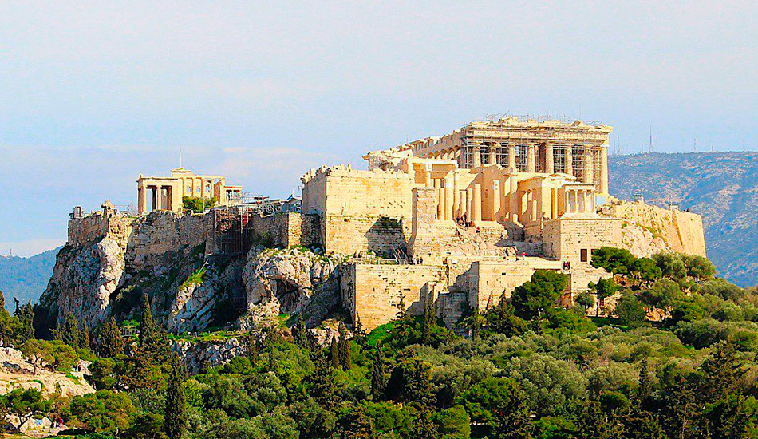

Slide 4
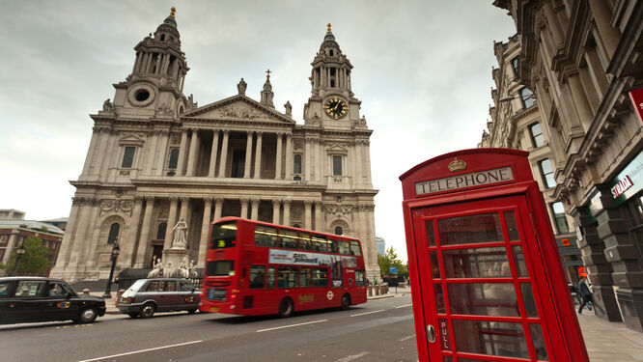

Slide 5
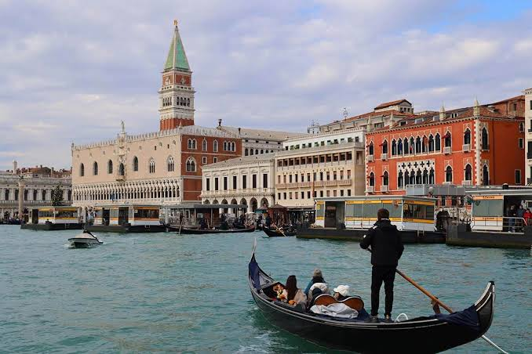

Slide 6
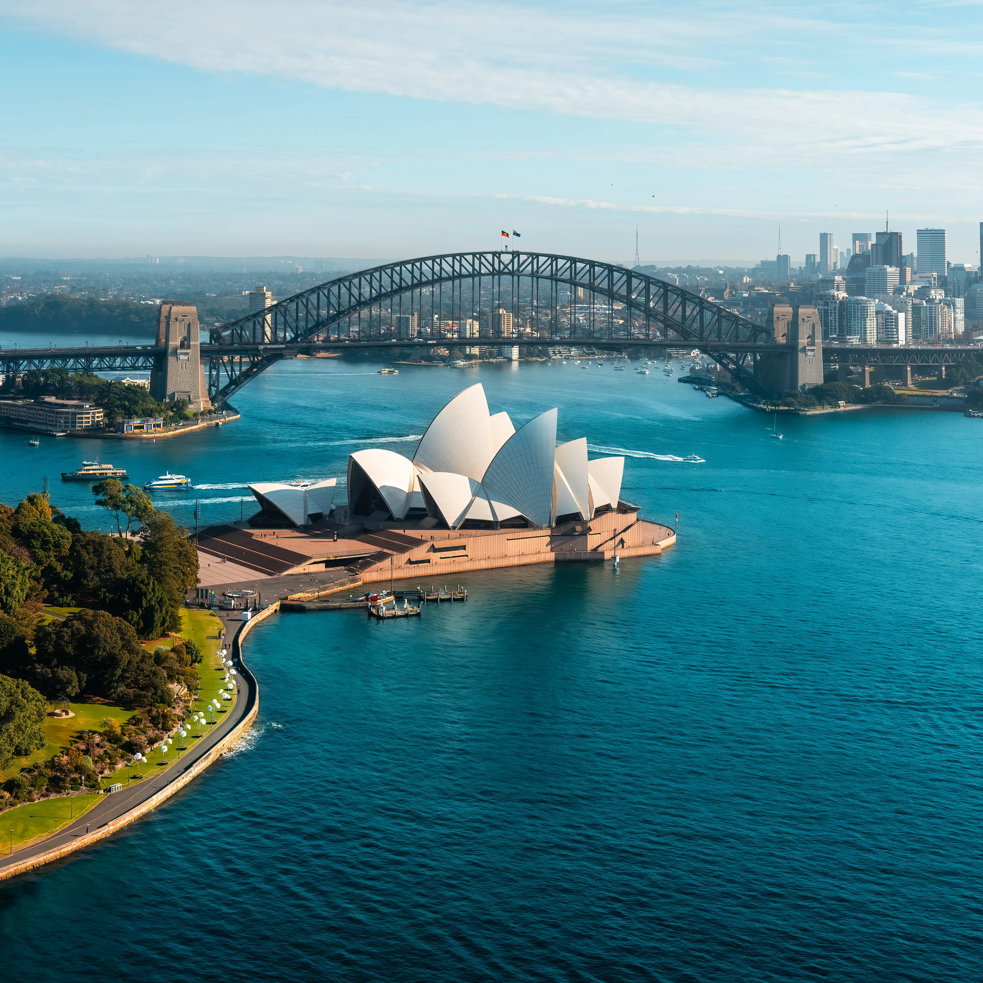

Slide 7
