Slide 1
Who is the mystery person?

Slide 2
They were born in Lanús, Argentina at 30 October 1960 and were dead in November 2 2020.

Slide 3
They were a footballer and were one of the two joint winners of the FIFA Player of the 20th Century award.

Slide 4
They played for Barcelona and wore the number 10 , won the the 1986 FIFA World Cup with Argentina , played as an attacking midfielder and second striker.
Have you guessed it. Who is it?

Slide 5
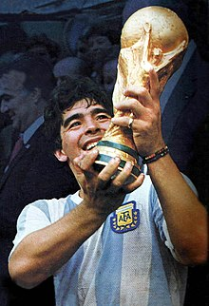
It’s Diego Armando Maradona

