Slide 1
Guess the Person!
Can you guess the mystery person?

Slide 2
CLUE #1
He was a British biologist of the 19th century, born in February 12 ,1809.

Slide 3
CLuE #2
He proposed the theory of evolution. He was the first one to say all beings came from a common ancestor. His beliefs were made fun of at first, but are now widely accepted by scientists all over the world.

Slide 4
CLUE #3
He was so fascinated by biology and animals, that he dropped out of medical school entirely.

Slide 5
Those were all the clues
So? Do you know who the mystery person is?

Slide 6
It’s…….

Slide 7
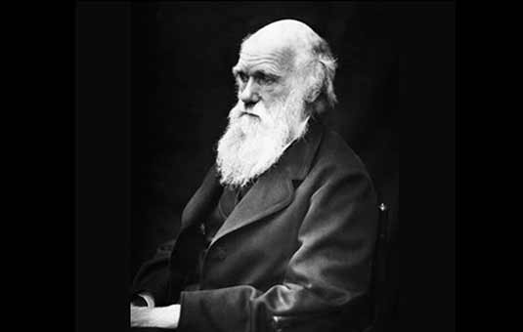
It’s Charles Darwin!

