Slide 1
Ανάλυση Δεδομένων Μάθησης (Learning Analytics)
Τζήμας Δημήτριος,
Συντονιστής Εκπ. Έργου Πληροφ. Δυτ. Μακεδονίας
detzimas@csd.auth.gr
blogs.sch.gr/dtzimas
Notes:
Η εισήγηση παρουσιάζει τη Θεωρία και Πρακτική του καινοτόμου ερευνητικού πεδίου της Ανάλυσης Δεδομένων Μάθησης (ή Μαθησιακή Αναλυτική, στα Αγγλικά: Learning Analytics) που εφαρμόζει μεθόδους ανάλυσης σε δεδομένα διαδράσεων οι οποίες συμβαίνουν σε περιβάλλοντα μάθησης (learning interactions).

Slide 2
Περιεχόμενα
Ανάλυση (Μαθησιακών) Δεδομένων
Python-based Analytics

Slide 3
1. Τι είναι η ανάλυση δεδομένων
Εξάγει σχέσεις και πρότυπα και απαντά σε ερωτήματα:
Τι συνέβη, πως και γιατί? Τι συμβαίνει τώρα? Προβλέψεις.
Notes:
Turning raw data to insights to make better decisions
Big data…
Στατιστική, πληροφορική, επιχειρησιακή έρευνα (Γραμμικός προγραμματισμός, ακέραιος προγραμματισμός, δυναμικός προγραμματισμός, ιεραρχική διαδικασία, στοχαστικός γραμμικός προγραμματισμός)
Η αναλυτική σε μεγάλα δεδομένα (big data analytics) είναι η χρήση προηγμένων τεχνικών ανάλυσης οι οποίες επεξεργάζονται big datasets για να εξάγουν χρήσιμα συμπεράσματα με σκοπό τη βελτίωση μεθόδων οργάνωσης και λήψης αποφάσεων …TEL

Slide 4
Τεχνικές Ανάλυσης Δεδομένων

Slide 5
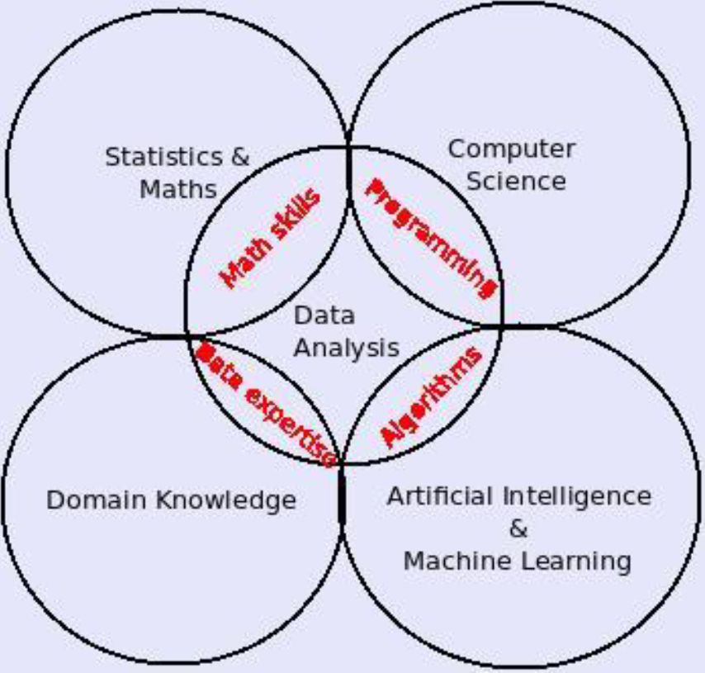
2. Ανάλυση Δεδομένων Μάθησης
Επστημολογία (What are we measuring, How)
Παιδαγωγική (Why, for Whom)
Αξιολόγηση (Where & When)
Notes:
Move from clicks to constructs in a principled way.
definitions

Slide 6
Τι είναι Ανάλυση Δεδομένων Μάθησης
Notes:
Κατανόηση και βελτιστοποίηση μάθησης και απόδοση ιδρύματος.

Slide 7
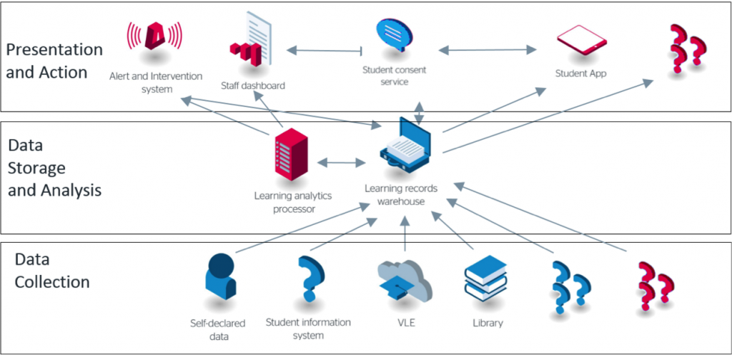
….

Slide 8
Υπολογιστικές μέθοδοι

Slide 9
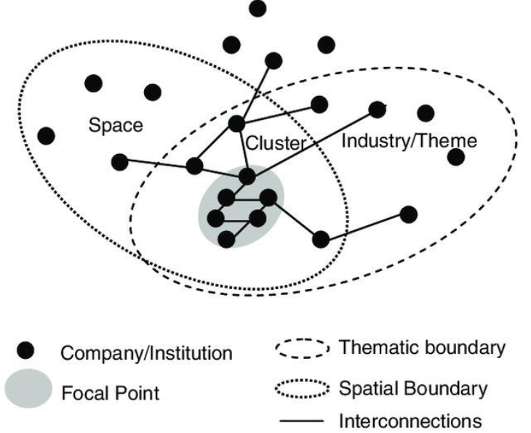
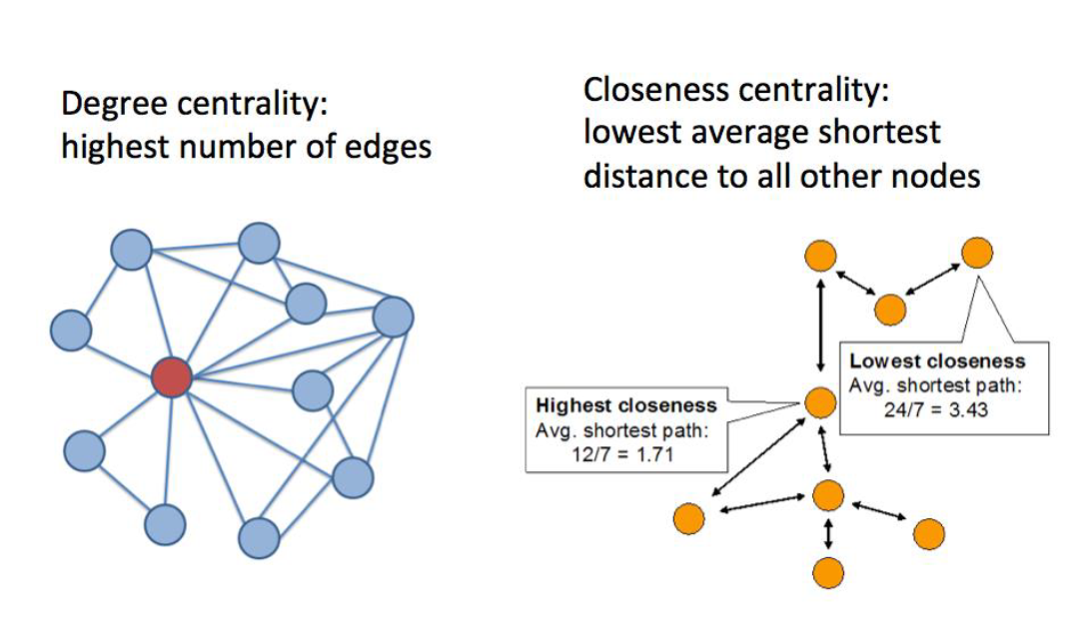
Υπολογιστικές μέθοδοι (Network Analytic methods)
Notes:
Move from clicks to constructs in a principled way.

Slide 10
- Constructs
Notes:
Abstract…concrete
How to measure…variables…attributes
Construct == latent variable measured with appropriate tests/instruments (observed variables-indicators)
Measurement models refer to the implicit or explicit models that relate the latent variable to its indicators.

Slide 11
3. Python-based analytics
Anaconda for Python 3.7 http://bit.ly/2JAPJu4
http://pytolearn.csd.auth.gr/ (scientific programming)
Jupyter Notebook
Επεξηγηματική & Προγνωστική
Python Βιβλιοθήκες numpy, scipy, pandas, matplotlib, statsmodels, scikit.
Notes:
Τεχνικές ανάλυσης δεδομένων (επεξηγηματικής όσο και προγνωστικής) σε περιβάλλον Python γράφοντας κώδικα με χρήση βιβλιοθηκών όπως:
numpy, (NumPy is the fundamental package for scientific computing with Python). It contains among other things:
a powerful N-dimensional array object
sophisticated (broadcasting) functions
tools for integrating C/C++ and Fortran code
useful linear algebra, Fourier transform, and random number capabilities
Besides its obvious scientific uses, NumPy can also be used as an efficient multi-dimensional container of generic data. Arbitrary data-types can be defined. This allows NumPy to seamlessly and speedily integrate with a wide variety of databases.
Scipy (it provides many user-friendly and efficient numerical routines such as routines for numerical integration and optimization),
matplotlib, (Matplotlib is a Python 2D plotting library which produces publication quality figures in a variety of hardcopy formats and interactive environments across platforms. Matplotlib can be used in Python scripts, the Python and IPython shells, the Jupyter notebook, web application servers, and for graphical user interface toolkits.)
statsmodels (statsmodels is a Python module that provides classes and functions for the estimation of many different statistical models, as well as for conducting statistical tests, and statistical data exploration. An extensive list of result statistics are available for each estimator. The results are tested against existing statistical packages to ensure that they are correct) http://bit.ly/2FudGhz
scikit. (Machine-learning in Python: Classiification, Regression, Clustering, Dimensionality Reduction, Model selection, Preprocessing) http://bit.ly/2Fzm679
Οι τεχνικές ανάλυσης δεδομένων (επεξηγηματικής και προγνωστικής, πχ. t-test, ANOVA, linear & logistic regression, classification, clustering, κ.λπ.) σε περιβάλλον Python (με χρήση του Jupyter Notebook και βιβλιοθηκών όπως numpy, scipy, matplotlib, pandas, και scikit) έχουν γενικότερη αξία καθώς μπορούν να εφαρμοστούν σε κάθε περίπτωση ανάλυσης δεδομένων και όχι μόνο μάθησης.
-Theory and Learning Analytics, Computational Methods
-Introduction to Python ecosystem and Jupyter Notebook
-Measurement and its Uses in Learning Analytics
-Δεδομένα, Numpy & Arrays, pandas & DataFrames
- Η βιβλιοθήκη numpy
- Η βιβλιοθήκη pandas

Slide 12
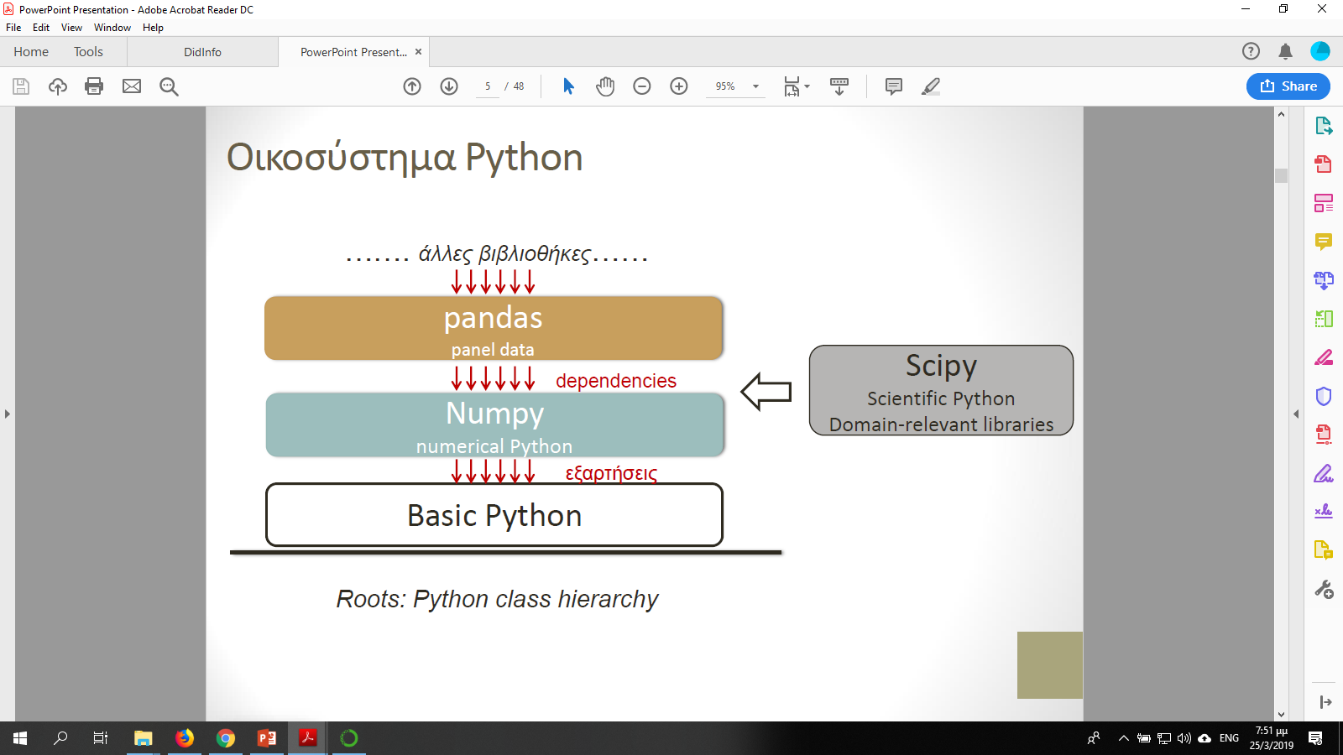
Pandas
Notes:
TREE METAPHOR
Python basics:
Python is an interpreted high-level general-purpose programming language
Python promotes code simplicity and readability
Open-source project
everything in Python is an object
List: Reduced efficiency is not a problem when data size is relatively small. But, it really turns to be a restriction when dealing with big data. This is also the reason for introducing a more efficient object, namely 'ndarray' (learn more about ndarrays in numpy (O(n))
Dictionary: mapping, collection, indexed, unordered, iterable, mutable
In operator. (hash table…efficiency…O(1))
Tuple: immutable, sequential, heterogeneous, ordered, indexed
Function: object reference
File handling
OOP
Μαθηματικό Πατρών, Αθήνας, Κρήτης,
Anaconda: Ανάλυση Big data και επιστημονικό προγραμματισμό (>450 βιβλιοθήκες)
Jupyter (Julia, Python & R):
Επιτρέπει να δημιουργείτε και διαμοιράζετε αρχεία με ‘ζωντανό’ κώδικα (live code), εξισώσεις, εικόνες, οπτικοποιημένο υλικό (εικόνες, video) και επεξηγηματικό κείμενο
Αποθηκεύστε ως html
Installers pip & conda
Control, cleaning, transform, modelling
Η βιβλιοθήκη numpy προσφέρει τη δομή Πίνακας (ndarray):
• Αποδοτική ομοιογενής δομή δεδομένων με υψηλή ταχύτητα επεξεργασίας
H numpy προσφέρει καλύτερη διαχείριση περισσότερων τύπων
• Η βιβλιοθήκη pandas προσφέρει τη δομή DataFrame:
• Ευέλικτη δομή δεδομένων, υψηλό επίπεδο οργάνωσης και ταχύτητα επεξεργασίας

Slide 13
Numpy
List: Reduced efficiency is not a problem when data size is relatively small. But, it really turns to be a restriction when dealing with big data. This is also the reason for introducing a more efficient object, namely ndarray.
Η βιβλιοθήκη numpy προσφέρει τη δομή Πίνακας (ndarray): Αποδοτική ομοιογενής δομή δεδομένων με υψηλή ταχύτητα επεξεργασίας. H numpy προσφέρει καλύτερη διαχείριση περισσότερων τύπων.

Slide 14
Numpy
NumPy is the fundamental package for scientific computing with Python. It contains among other things:
a powerful N-dimensional array object
sophisticated (broadcasting) functions
tools for integrating C/C++ and Fortran code
useful linear algebra, Fourier transform, and random number capabilities
Besides its obvious scientific uses, NumPy can also be used as an efficient multi-dimensional container of generic data. Arbitrary data-types can be defined. This allows NumPy to seamlessly and speedily integrate with a wide variety of databases.
Numerical Python
Scientific programming
Big Data analysis
Array oriented computing
import numpy as np
Διανυσματοποίηση
Notes:
ndarray τύπο
dtype property
constructor arange
shape property
Speed of code execution
Vectorization
ar = np.array([1,2,3,4,5])
print(ar,'\n’)
Σύνοψη:
Κατασκευάζω με: array(), arange()
• Διαμορφώνω με: reshape()
• Καθορίζω τύπο δεδομένων: dtype
• Αλλάζω τύπο πίνακα: astype()
• Περισσότεροι τύποι δεδομένων στη Numpy (σε σχέση με βασική Python)
• Βασικές ιδιότητες: ndim, shape, dtype, itemsize, size
• Ειδικές μορφές: zeros, ones, eye, empty, linspace
Οι πίνακες είναι ομοιογενείς δομές
Δεικτοδότηση: Ακέραιος δείκτης (όπως στις Λίστες)
• Διδιάστατος Πίνακας: [Σειρά, Στήλη]
• Τριδιάστατος: [Δείκτης-2Δ, Σειρά, Στήλη]
• Ανάθεση Τιμής: Εντολή ανάθεσης
• Προσοχή: Οι Πίνακες ομοιογενής δομή. Όχι ανάθεση διαφορετικού τύπου
• Τομές: [start, stop, step] (όπως στις Λίστες)
• Τομές: Δημιουργούν Όψεις του Πίνακα
Vectorization
Υπερφόρτωση τελεστών
Broadcasting
Boolean & integer list mask
Universal functions
Διανυσματοποίηση (vectorization)
• Προβολή (broadcasting)
• Ιδιότροπη δεικτοδότηση (fancy indexing)
• Μάσκες λογικού τύπου
• Μάσκες ακεραίων
• Συναρτήσεις Πινάκων
• Καθολικές συναρτήσεις
• Κανονικές συναρτήσεις
• Άξονας (axis) ndim property
arange:
zeros()
ones()
eye()
linspace()
Indexing
Array broadcasting
Fancy indexing
Array slicing

Slide 15
Matplotlib
matplotlib, (Matplotlib is a Python 2D plotting library which produces publication quality figures in a variety of hardcopy formats and interactive environments across platforms. Matplotlib can be used in Python scripts, the Python and IPython shells, the Jupyter notebook, web application servers, and for graphical user interface toolkits.)
pyplot module (very similar to Matlab)
import numpy as np
import matplotlib.pyplot as plt
%matplotlib inline
x = np.linspace(0, 2*np.pi, 100);
y = np.sin(x) plt.plot(x, y)
Notes:
Plotting the data of a Series or DataFrame object can be accomplished by using the matplotlib.pyplot methods and functions
plot()

Slide 16
Pandas
Υψηλής ευελιξίας και αποδοτικότητας βιβλιοθήκη για την οργάνωση & ανάλυση δεδομένων
Προσφέρει φιλικές προς το χρήστη δομές δεδομένων με ονόματα, (βασισμένες στα λεξικά της Python και τους πίνακες της Numpy)
Οργάνωση δεδομένων σε 2 βασικά αντικείμενα: DataFrame & Series
Πλεονεκτήματα:
Α) Εισαγωγή δεδομένων από διάφορα αρχεία (xls, csv, text, json, κ.ά.)
Β) Οργάνωση δεδομένων σε δομές-πίνακα (table-like) με ετικέτες
Γ) Υψηλή ευελιξία στην ανάλυση δεδομένων
Δ) Συνεργασία με Scipy (και άλλες βιβλιοθήκες) για εφαρμογή μεθόδων επεξεργασίας δεδομένων
Notes:
pandas (always written in lower case) is an open-source high-level and high-performance library for data analysis in the Python ecosystem
Although numpy already offers the ndarray object and many relevant functions for data processing, working with numpy remains at a low performance level as the data representation is most of the time not user friendly.
By contrast, pandas provides easy-to-use labeled data structures and high level data manipulation tools (based on Python dictionaries and numpy arrays) rendering data analysis and processing extremely more understandable and efficient for humans.
Overall, pandas is built on top of numpy and offers to scientist/programmer sophisticated data manipulation features that are expected to significantly increase productivity.
The library name comes from panel data, a term for multidimensional data sets in statistics and econometrics (πολλαπλή παλινδρόμηση).

Slide 17
Pandas
import pandas as pd
Frame (read_ & to_)
read_csv
read_excel
read_json
Notes:
import pandas as pd
from pandas import Series
from pandas import DataFrame
# two major data structures
Suppose you have collected your data from your educational technology research project. Your subjects are school students who have been working following some innovative technology-supported didactic model. You have entered your data in a spreadsheet and now you are ready to proceed with processing. Naturally, in your student samples there are both boys and girls and you think that it would be nice if you could group your students based on gender and do some boys-girls group comparisons. Furthermore, you have data coming from classes of different age/level (say, K6 and K9). Wouldn't it be nice to further group your data based also on students' level? Here is where 'groupby' comes in.
'groupby' is a pandas powerful method for grouping and dividing your original data into subgroups, based on one or more grouping factor(s) that you consider important (like gender and age in the above scenario). After grouping you can proceed and implement all available numpy/scipy/pandas-based statistics in the subgroups thus increasing the power of your analysis. Of course, you need to additionally enter in your data spreadsheet the information necessary for grouping (the grouping factor(s)).

Slide 18
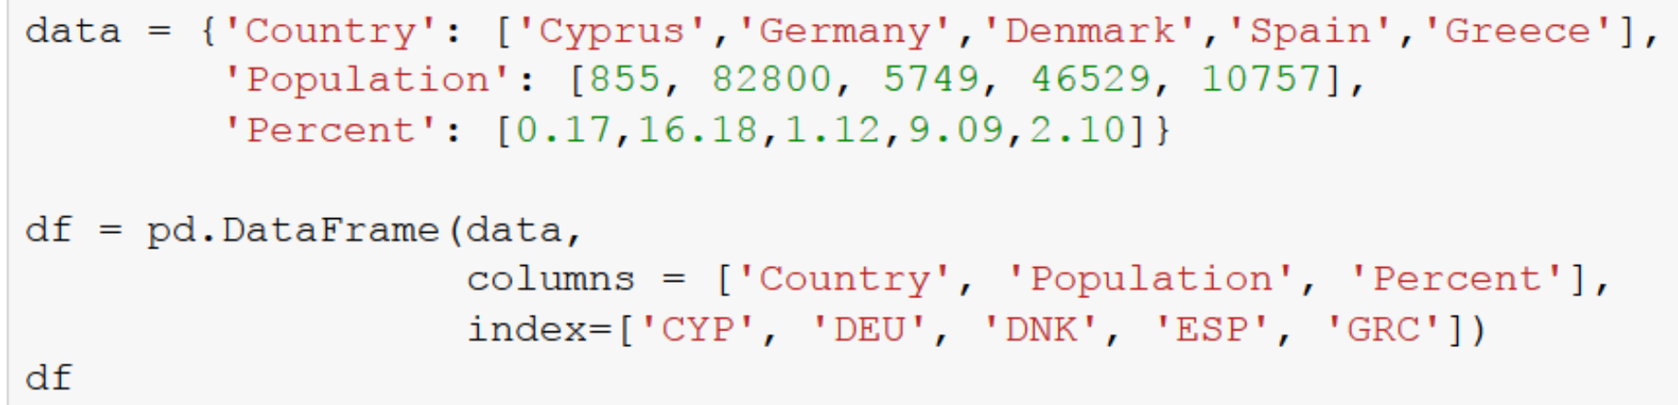
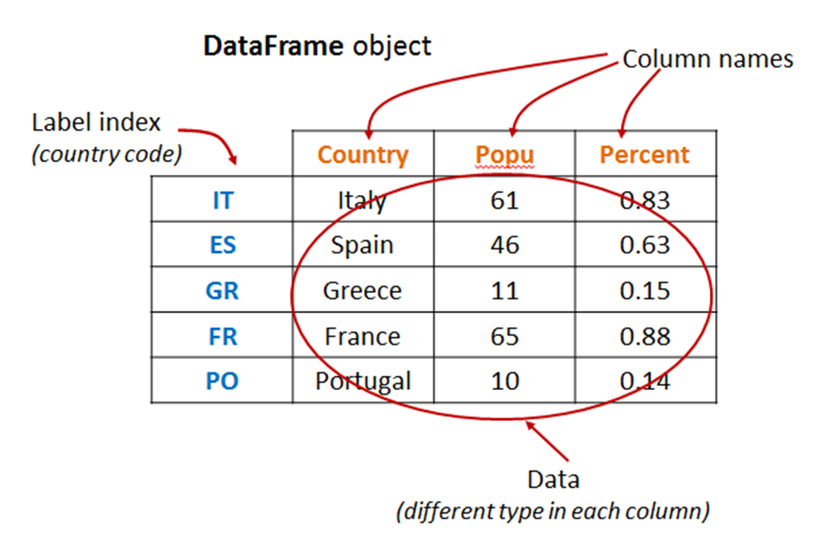
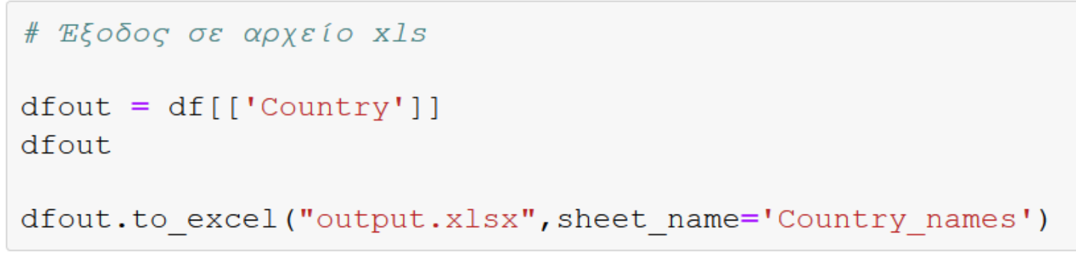
DataFrame (Pandas)
Notes:
A DataFrame object is a multi-dimensional table-like data structure (similar to a multidimensional array) containing a labeled collection of columns, each of which can be a different value type (numeric, string, boolean, etc.).
Thus, for each country you have a row of data (instead of just a column entry as in a Series object). Suppose also that your country data are still label-indexed by the country two-letter code. The DataFrame object for this data representation would look like the following: Data for each country in rows
Index labels (country code) for each country (row)
Names for each column
df.index
df.columns
df.values
read_csv

Slide 19
Series (Pandas)
import pandas as pd
s = pd.Series([10,20,30,40,50], dtype='int')
print(s)
print(s.index, s.values)
import numpy as np
import pandas as pd
s = pd.Series(np.array([chr(i) for i in range(65,70)]))
print(s)
print(s.index, s.values)
Notes:
A Series object is a one-dimensional array (similar to that of numpy ndarray) but with a significant addition: it includes a data label index (even if one is not explicitly specified).
Όταν παίρνουμε μία μόνο στήλη δεδομένων από DataFrame (με απλή δεικτοδότηση όπως στο παράδειγμα) η δομή που προκύπτει ονομάζεται Series
• Περιλαμβάνει: Δεδομένα οργανωμένα σε 1 στήλη με ετικέτα (labeled data)
A Series (just like ndarrays) is an object supporting vectorized operations
Σύνοψη
• Εισαγωγή δεδομένων από αρχείο xls
• Βασικές ιδιότητες: index, columns, values
• Κατασκευή από Λεξικό
• Έξοδος σε αρχείο xls
• Δεικτοδότηση (Indexing) δεδομένων
• Διαχείριση DataFrame
Asking For Help
>>> help(pd.Series.loc)
I/O
Read and Write to CSV
Read and Write to SQL Query or Database Table
>>> pd.read_csv('file.csv', header=None, nrows=5)
>>> df.to_csv('myDataFrame.csv')
>>> from sqlalchemy import create_engine
>>> engine = create_engine('sqlite:///:memory:')
>>> pd.read_sql("SELECT * FROM my_table;", engine)
>>> pd.read_sql_table('my_table', engine)
>>> pd.read_sql_query("SELECT * FROM my_table;", engine)
Read and Write to Excel
>>> pd.read_excel('file.xlsx')
>>> pd.to_excel('dir/myDataFrame.xlsx', sheet_name='Sheet1')
Read multiple sheets from the same file
>>> xlsx = pd.ExcelFile('file.xls')
>>> df = pd.read_excel(xlsx, 'Sheet1')
read_sql()is a convenience wrapper
>>> pd.to_sql('myDf', engine)

Slide 20
Έλεγχος υποθέσεων (Hypothesis testing)
Research design:
Quantitative paradigm (rigorous testing/predicting methods)
Qualitative paradigm (deeper understanding)
Mixed-method paradigm
Experimental design
Notes:
Applicability
Implementation details (know-how)
Reporting
Experimental (treatment) group vs. control group
Sampling (random)
Measuring (measured construct, measuring instrument)
Reliability
Validity
Reject the null hypothesis…statistically significant impact…
Ho and H1 are taken together they are mutually exclusive and exhaustive (they leave no other alternative)
Signal to noise
Variability
Probability distribution
In educational studies we are satisfied with a probability cutoff value of 0.05 (the a level)
In critical medical studies where the 'a cutoff level' is usually set at 0.001

Slide 21
Κατανομές (Distributions)
import scipy.stats as stats # Imports the entire scipy.stats (all distributions)
from scipy.stats import norm # imports only the normal distribution
from scipy.stats import t # imports only the Student's t distribution (see t-test)
from scipy.stats import f # imports only the Fisher's f distribution (F-test)
norm.pdf(x) = exp(-x**2/2)/sqrt(2*pi)
median(), mean(), std(), var(), stats()
Notes:
distribution of a variable is an expression of the probability that when measuring the variable the result will lie within a specific range of values. Depending on how the variable varies, distribution can be either:
Discrete
Continuous
Computational statistics
Probability density function
Cumulative distribution function
Percent point function
Survival function
Normal (Gaussian) distribution

Slide 22
Statistical controls
Descriptive statistics:
mean(), median(), std(), var(), min(), max(), skew(), kurt()
data.corr(method=‘spearman’)
data.cov()

Slide 23
Test for differences between 2 groups
t-test (independent samples)
stats.shapiro() #Shapiro-Wilk test for normality criterion
stats.levene() #Variance criterion
stats.ttest_ind()
Stats.mannwhitneyu() #non parametric… of the t-test
Paired t-test
One sample t-test
Notes:
t-test: does an independent variable (IV) have an impact on a dependent variable (DV)’?
t-test conditions and criteria
Be warned that the above formula is valid when:
The sample sizes are the same: n₁ = n₂ = n
The populations (where the samples come from) follow the normal distribution (normality criterion), and
The variances of the populations are also the same (variety criterion)

Slide 24
Paired t-test
t-test (related samples)
stats.shapiro() #Shapiro-Wilk test for normality criterion
stats.levene() #Variance criterion
stats.ttest_rel()
stats.wilcoxon() #non parametric… of the paired t-test
Notes:
Paired t-test is the type of t-test that we apply when we want to explore whether the two means of two related samples are significantly different.
Usually, "related" refers to the fact that we use the same sample in a "test-retest" ("repeated measures") research design, thus forming pairs of repeated measurements for the same participant.

Slide 25
One sample t-test
t-test (related samples)
stats.shapiro() #Shapiro-Wilk test for normality criterion
stats.ttest_1samp()
Notes:
EDUCATIONAL RESEARCH
import pandas as pd
import scipy.stats as stats
data = pd.read_excel('../../data/researchdata.xlsx', sheetname="ttest-indep") print(data.Treatment.head(),'\n’)
print(data.Treatment.describe()

Slide 26
Test for differences between 3 or more groups
One-way ANOVA
stats.shapiro()
stats.levene()
F, p = stats.f_oneway(dC, dT1, dT2)
tukeyhsd()
Notes:
ANalysis Of Variance
The ANOVA name (from 'ANalysis Of VAriance') stands for a family of statistical controls that test for statistical significance between sample means by examining the sample variances.
When we simply refer to 'ANOVA', we usually mean the 'one way' ANOVA which is a test for exploring the impact of one single factor on three or more groups (but two groups would also do, as we explain below).
Three groups post-test only design
As p < a (0.05) we state that we have a main interaction effect.
So, when ANOVA reports 'interaction effect' we need to further identify the group pairs by applying pair-wise controls. Although these controls could be done by implementing ordinary t-test (as demonstrated below) this is not the right approach … Apply Tukey's test
Repeated measures (or "within subjects") ANOVA is the ANOVA counterpart of the 'paired sample' t-test. We apply a repeated measures ANOVA (or 'rANOVA') when the dependent variable is measured for the same subjects (patients, students, etc.) at different times or under different conditions.
Two-way ANOVA (factorial)
ANCOVA: Analysis of Covariance is a powerful analysis method in the ANOVAs family, with one significant feature: it considers also the correlation between your measured dependent variable and another independent variable (the covariate).

Slide 27
Building models in Python (supervised learning)
Γραμμική Παλινδρόμηση (Linear Regression)
Statsmodels
Scikit-learn
Scipy library
import statsmodels.api as sm
X = df["RM"]
y = target["MEDV"]
# Note the difference in argument order
model = sm.OLS(y, X).fit()
predictions = model.predict(X) # make the predictions by the model
# Print out the statistics
model.summary()
Notes:
Linear regression is a statistical model that examines the linear relationship between two (Simple Linear Regression ) or more (Multiple Linear Regression) variables — a dependent variable and independent variable(s). Linear relationship basically means that when one (or more) independent variables increases (or decreases), the dependent variable increases (or decreases) too:
Statsmodels is “a Python module that provides classes and functions for the estimation of many different statistical models, as well as for conducting statistical tests, and statistical data exploration.” (from the documentation)
import statsmodels.api as sm

Slide 28
Building models in Python (unsupervised learning)
# import KMeans
from sklearn.cluster import KMeans
# import statements
from sklearn.datasets import make_blobs
import numpy as np
import matplotlib.pyplot as plt
# create blobs
data = make_blobs(n_samples=200, n_features=2, centers=4,
cluster_std=1.6, random_state=50)
# create np array for data points
points = data[0]
# create scatter plot
plt.scatter(data[0][:,0], data[0][:,1], c=data[1], cmap='viridis')
plt.xlim(-15,15)
plt.ylim(-15,15)
# create kmeans object
kmeans = KMeans(n_clusters=4)
# fit kmeans object to data
kmeans.fit(points)
# print location of clusters learned by kmeans object
print(kmeans.cluster_centers_)
# save new clusters for chart
y_km = kmeans.fit_predict(points)

Slide 29
Τεχνητή Νοημοσύνη με Python (text mining)
e.g. sentiment analysis, text classification
NLTK
import nltk
sent_tokenize / word_tokenize #tokenization
FreqDist() #frequency distribution
# top words = noise to the text
# Lexicon normalization
# Part Of Speech Tagging
Notes:
From social media analytics to risk management and cybercrime protection, dealing with text data has never been more important.
Preprocessing
Feature extraction
NLTK is a powerful Python package that provides a set of diverse natural languages algorithms. It is free, opensource, easy to use, large community, and well documented. NLTK consists of the most common algorithms such as tokenizing, part-of-speech tagging, stemming, sentiment analysis, topic segmentation, and named entity recognition. NLTK helps the computer to analysis, preprocess, and understand the written text.

Slide 30
Χρήσιμοι σύνδεσμοι
http://pytolearn.csd.auth.gr/
https://analytics.jiscinvolve.org/wp/ (JISC)
https://solaresearch.org/
https://lak19.solaresearch.org/
https://jedm.educationaldatamining.org/index.php/JEDM
http://bit.ly/2Qcsg4s
http://bit.ly/2QdonMI

Slide 31
Take Away
…
Notes:
Professional LA

Slide 32
Σας ευχαριστώ για την προσοχή σας! http://blogs.sch.gr/dtzimas

