Slide 1
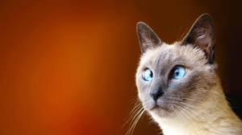
List as many ways as you can think of how humans use animals

Slide 2
Objective:
What do we need to achieve?
Outcome:
How will we achieve this?
Evaluate the uses of animals
Identify some uses of animals
Analyse the attitudes towards the uses of animals

Slide 3
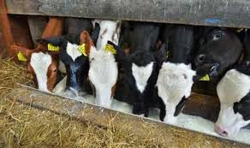
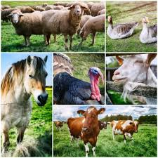
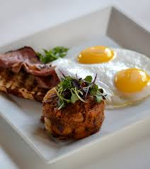
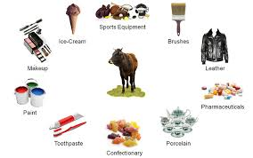
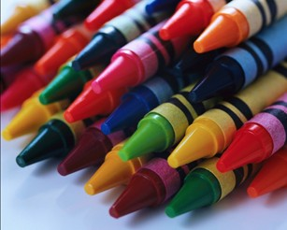
...as a resource

Slide 4
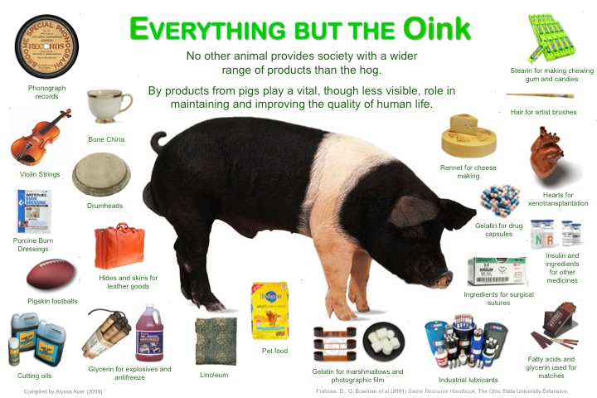

Slide 5
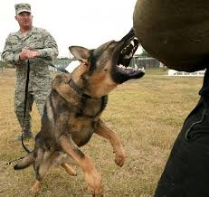
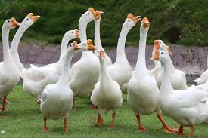
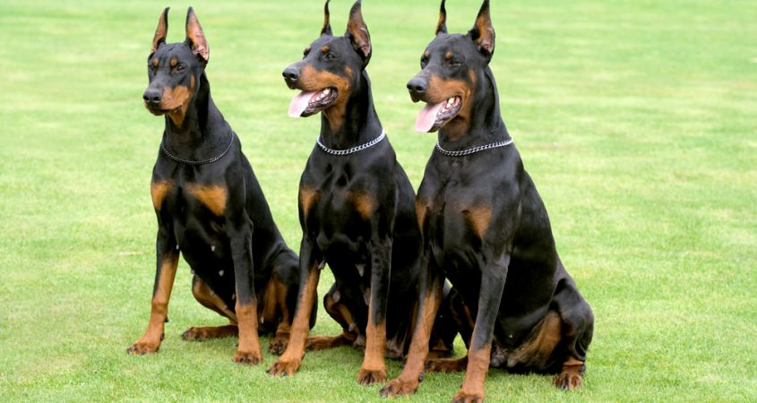
...as security

Slide 6
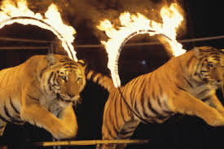
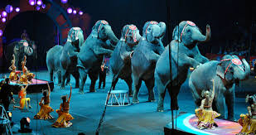
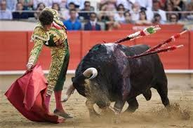
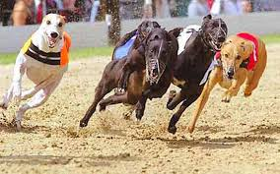
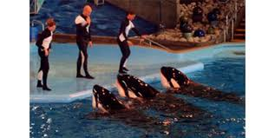
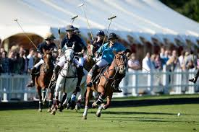
...in entertainment and sports

Slide 7
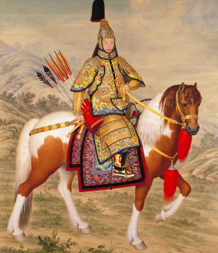
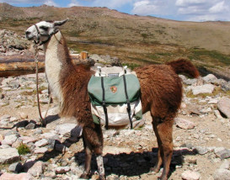
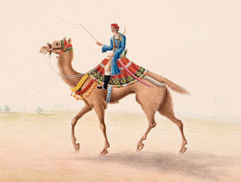
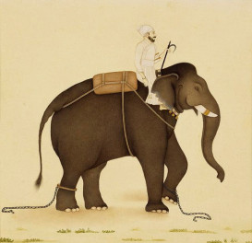
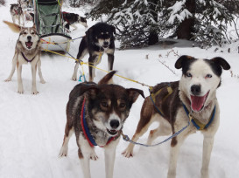
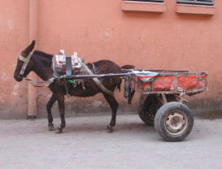
...as transport

Slide 8
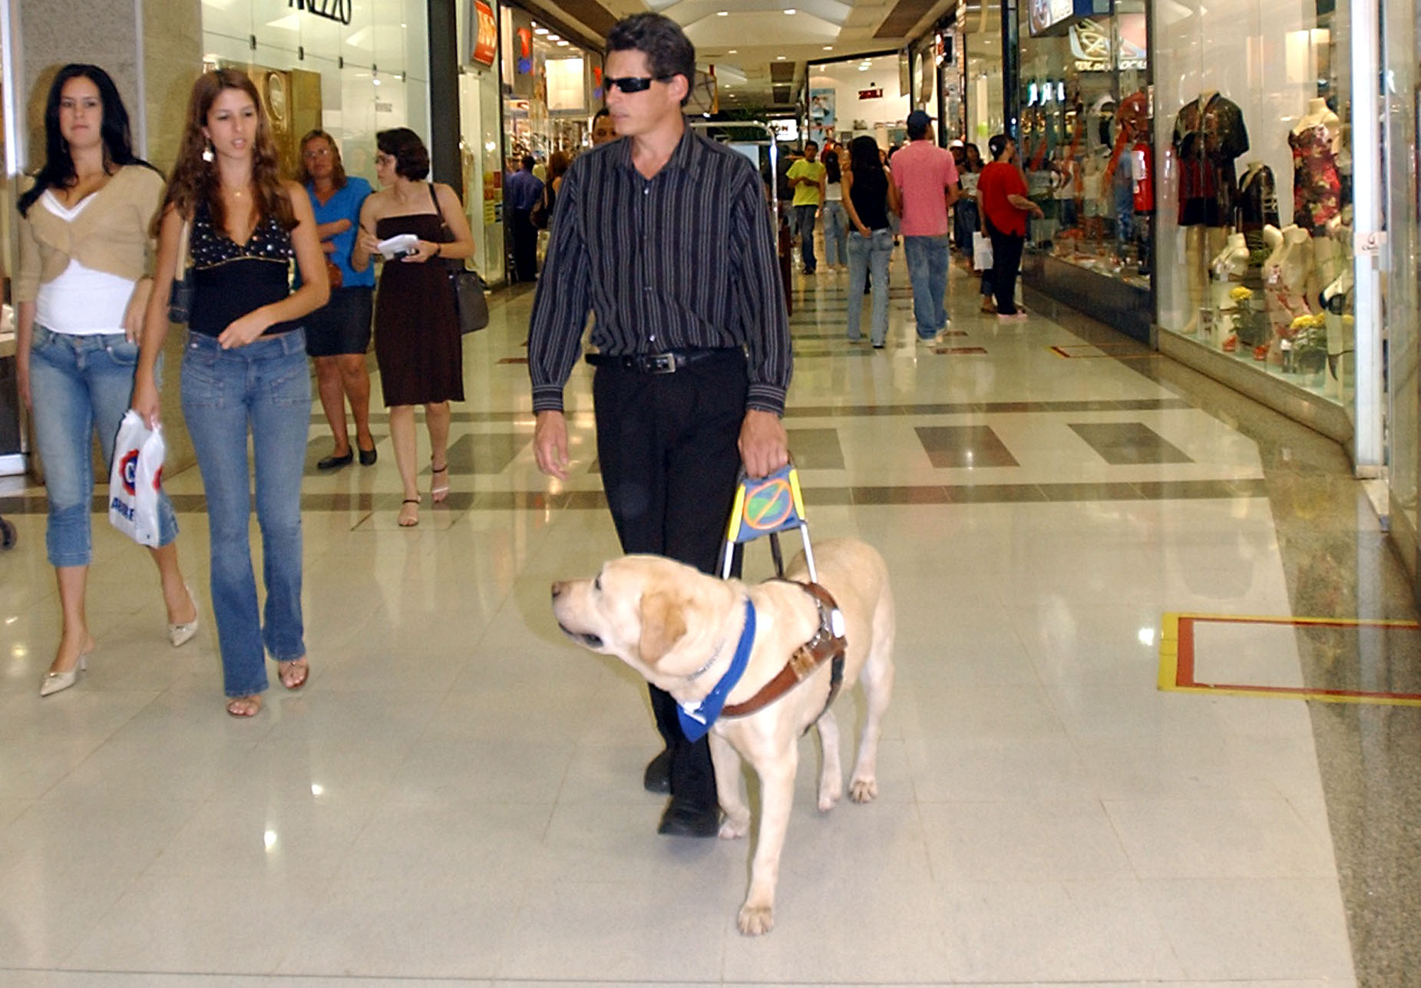
Helping the needy as service animals!
A service animal is any dog that is individually trained to do work or perform tasks for the benefit of an individual with a disability, including a physical, sensory, psychiatric, intellectual, or other mental disability. Other species of animals, whether wild or domestic, trained or untrained, are not considered service animals.

Slide 9
The work or tasks performed by a service animal must be directly related to the individual’s disability. Examples of work or tasks include, but are not limited to:
Assisting individuals who are blind or have low vision with navigation and other tasks.
Alerting individuals who are deaf or hard of hearing to the presence of people or sounds.
Providing non-violent protection or rescue work.
Pulling a wheelchair.
Assisting an individual during a seizure.
Alerting individuals to the presence of allergens.
Retrieving items such as medicine or the telephone.
Providing physical support and assistance with balance and stability to individuals with mobility disabilities.
Helping individuals with psychiatric and neurological disabilities by preventing or interrupting impulsive or destructive behaviors.

Slide 10
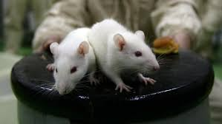
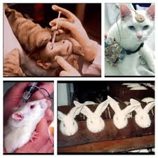
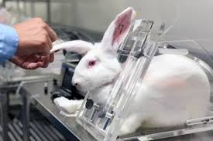
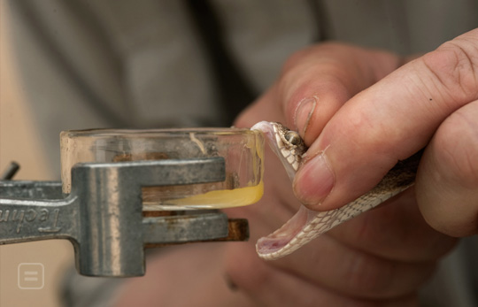
...in medicine

Slide 11
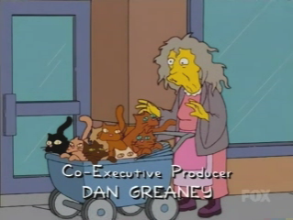
To keep us company

Slide 12
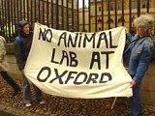
What is a Vivisection?
It literally means: "To cut up a living thing”
“Vivisection” is a word used to describe painful experiments
performed on animals.
According to the British Union against Vivisection:
200million animals are experimented on each year
13000, scientists work in 300 laboratories in the UK
Over 2.5 million animals are experimented on in the UK per year
Over 63% of experiments do not use anaesthetic!

Slide 13
Key words
Respect
Equality
Stewardship
Dominion
a feeling of deep admiration for someone or something elicited by their abilities, qualities, or achievements
the state of being equal, especially in status, rights, or opportunities
To be put in charge of something and to look after it for future generations
To be put in charge of something

Slide 14
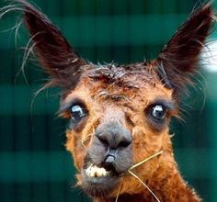
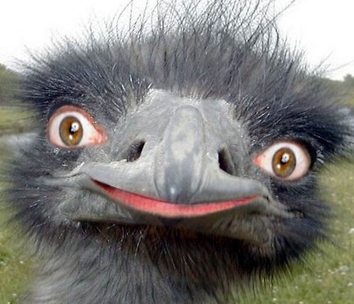
Should people use animals? Explain and describe with the use of previous knowledge.
In my opinion, I believe…
This is supported by ...
This means….
Another reason is…
This is supported by the example of...
This means….

