Slide 1
Fast fashion

Slide 2

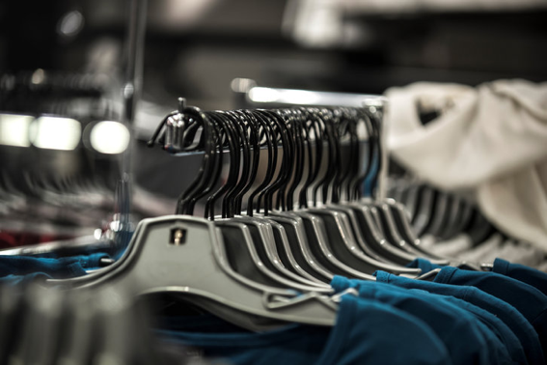
Fast fashion
What is fast fashion?
Think and share your ideas.
www.teachingenglish.org.uk
© British Council 2021 The United Kingdom’s international organisation for educational opportunities and cultural relations. We are registered in England as a charity.

Slide 3
Definition
Clothes that are made and sold cheaply, so that people can buy new clothes often.
definition: Clothes that are made and sold cheaply, so that people can buy new clothes often.

Slide 4

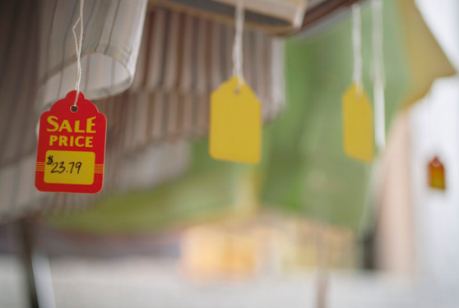
Fast fashion
Where can you buy fast fashion in your town?
What kinds of people buy fast fashion? Why?
What are the pros and cons of fast fashion?
Where can you get clothes that aren’t fast fashion?
Think and share your ideas.
www.teachingenglish.org.uk
© British Council 2021 The United Kingdom’s international organisation for educational opportunities and cultural relations. We are registered in England as a charity.

Slide 5
Word | Definition
1. item (n) | a. a place where large amounts of rubbish are buried
2. produce (v) | b. natural materials, such as cotton or wool
3. carbon emissions (n) | c. material used to make clothes etc.
4. landfill site (n) | d. one object or unit
5. biodegradable (adj) | e. break up into small parts and disappear with time
6. decompose (v) | f. chemicals that are dangerous for the environment
7. recyclable (adj) | g. relating to the whole world
8. raw materials (n) | h. make, create
9. textile (n) | i. able to be recycled, used again
10. global (adj) | j. able to decay naturally, without causing harm
www.teachingenglish.org.uk
© British Council 2021 The United Kingdom’s international organisation for educational opportunities and cultural relations. We are registered in England as a charity.

Slide 6
Word | Definition
1. item (n) | d. one object or unit
2. produce (v) | h. make, create
3. carbon emissions (n) | f. chemicals that are dangerous for the environment
4. landfill site (n) | a. a place where large amounts of rubbish are buried
5. biodegradable (adj) | j. able to decay naturally, without causing harm
6. decompose (v) | e. break up into small parts and disappear with time
7. recyclable (adj) | i. able to be recycled, used again
8. raw materials (n) | b. natural materials, such as cotton or wool
9. textile (n) | c. material used to make clothes etc.
10. global (adj) | g. relating to the whole world
www.teachingenglish.org.uk
© British Council 2021 The United Kingdom’s international organisation for educational opportunities and cultural relations. We are registered in England as a charity.

Slide 7
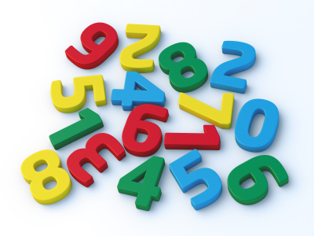
Numbers
90% - Ninety per cent
150,000,000
3.6
6,280
www.teachingenglish.org.uk
© British Council 2021 The United Kingdom’s international organisation for educational opportunities and cultural relations. We are registered in England as a charity.

Slide 8
Number pronunciation
  150,000,000 = a hundred and fifty million (not millions)
  3.6 = three point six
  6,280 = six thousand two hundred and eighty
www.teachingenglish.org.uk
© British Council 2021 The United Kingdom’s international organisation for educational opportunities and cultural relations. We are registered in England as a charity.

Slide 9
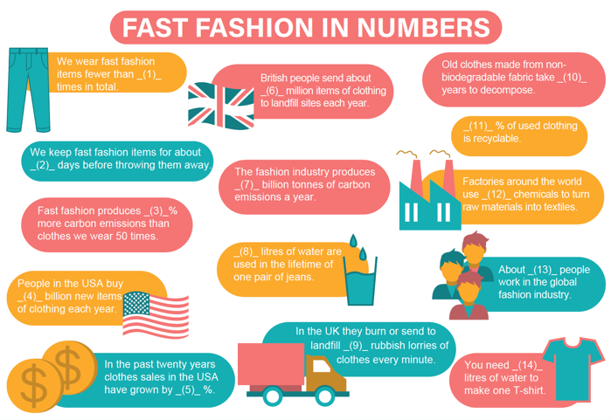
www.teachingenglish.org.uk
© British Council 2021 The United Kingdom’s international organisation for educational opportunities and cultural relations. We are registered in England as a charity.

Slide 10
1.2 400 400 235 200
99 80
3,781 2,700 5 60 8,000
35 60,000,000
www.teachingenglish.org.uk
© British Council 2021 The United Kingdom’s international organisation for educational opportunities and cultural relations. We are registered in England as a charity.

Slide 11
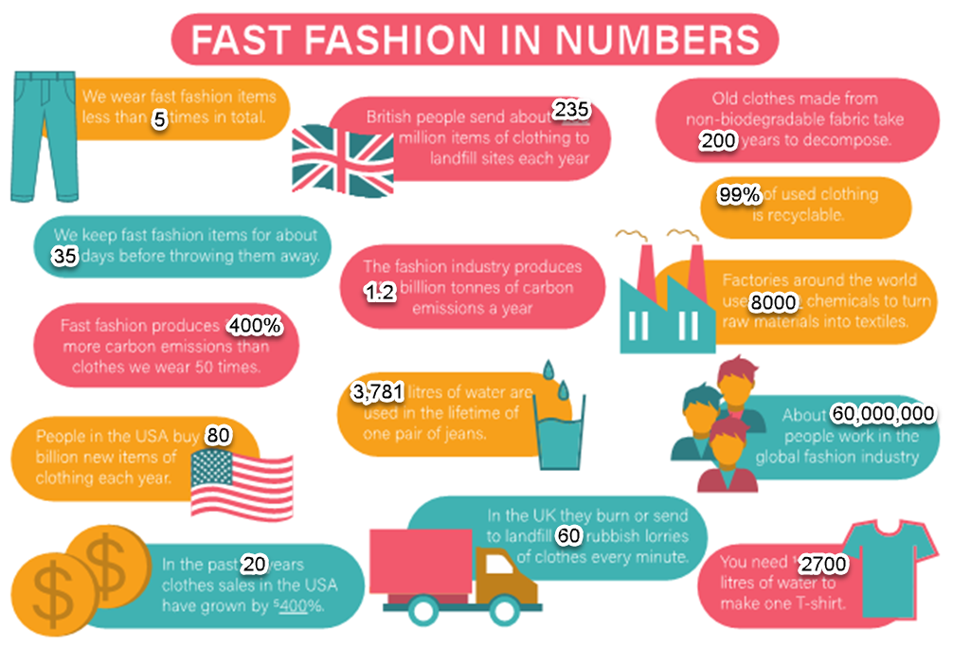
www.teachingenglish.org.uk
© British Council 2021 The United Kingdom’s international organisation for educational opportunities and cultural relations. We are registered in England as a charity.

Slide 12
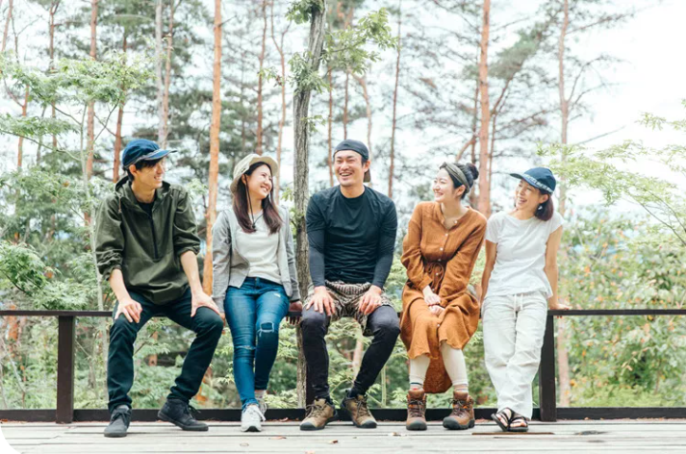
Discussion
− How does the information make you feel?
− How can we change the situation?
− Where can we get clothes that aren’t fast fashion?
www.teachingenglish.org.uk
© British Council 2021 The United Kingdom’s international organisation for educational opportunities and cultural relations. We are registered in England as a charity.

Slide 13

To upcycle
Think and share your ideas.
www.teachingenglish.org.uk
© British Council 2021 The United Kingdom’s international organisation for educational opportunities and cultural relations. We are registered in England as a charity.

Slide 14
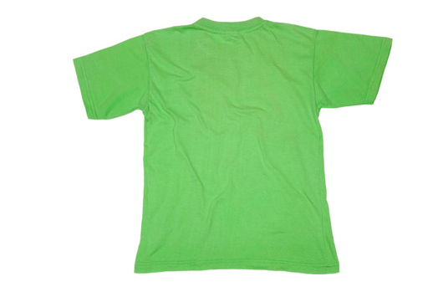
Upcycling a T-shirt
What do you do with your old T-shirts?
How can you upcycle an old T-shirt?
Think and share your ideas.
www.teachingenglish.org.uk
© British Council 2021 The United Kingdom’s international organisation for educational opportunities and cultural relations. We are registered in England as a charity.

Slide 15
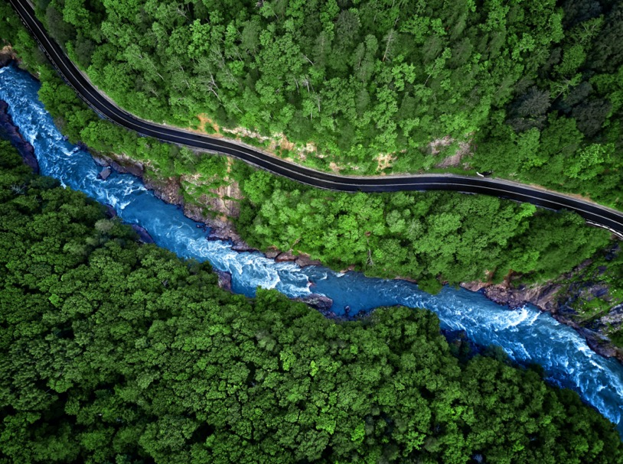
Fast fashion
www.teachingenglish.org.uk
© British Council 2021 The United Kingdom’s international organisation for educational opportunities and cultural relations. We are registered in England as a charity.

