Slide 1
Unit 1
A refugee’s
dreamland

Slide 2
reading
Comprehension

Slide 3
Migration is a global phenomenon creating a refugee crisis

Slide 4

Why do refugees come to Europe?
Add Text
Add Text
01
03
Add Text
Add Text
02
04

Slide 5
01
Holiday Destination
02
Seasonal work
03
Visit relatives
Greek Islands
04
Being a refugee

Slide 6
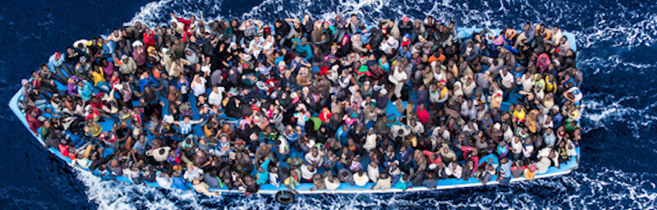
travelling

Slide 7
In extremely harsh conditions
travel

Slide 8
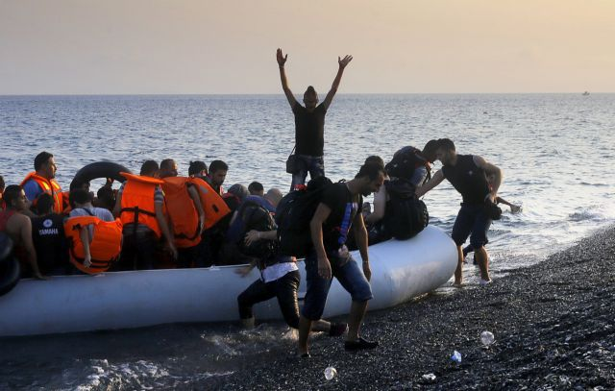
To live like humans in better civilised conditions

Slide 9
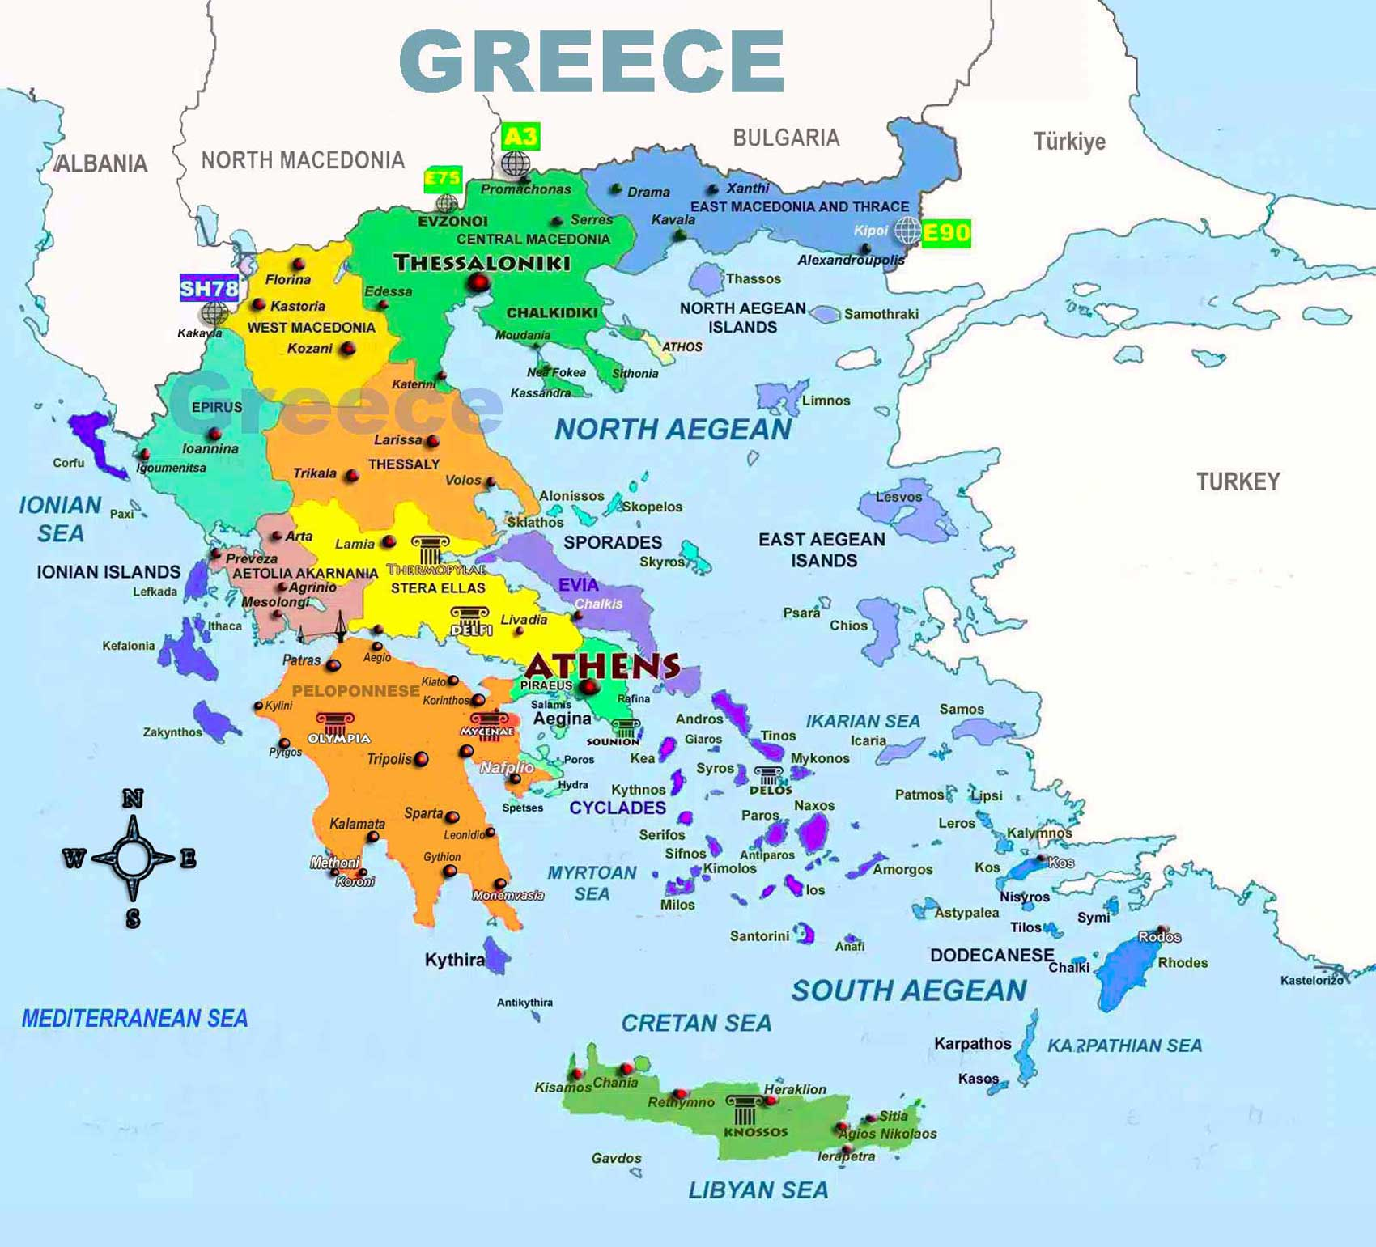
Tilos Island

Slide 10
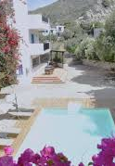
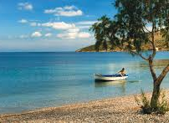
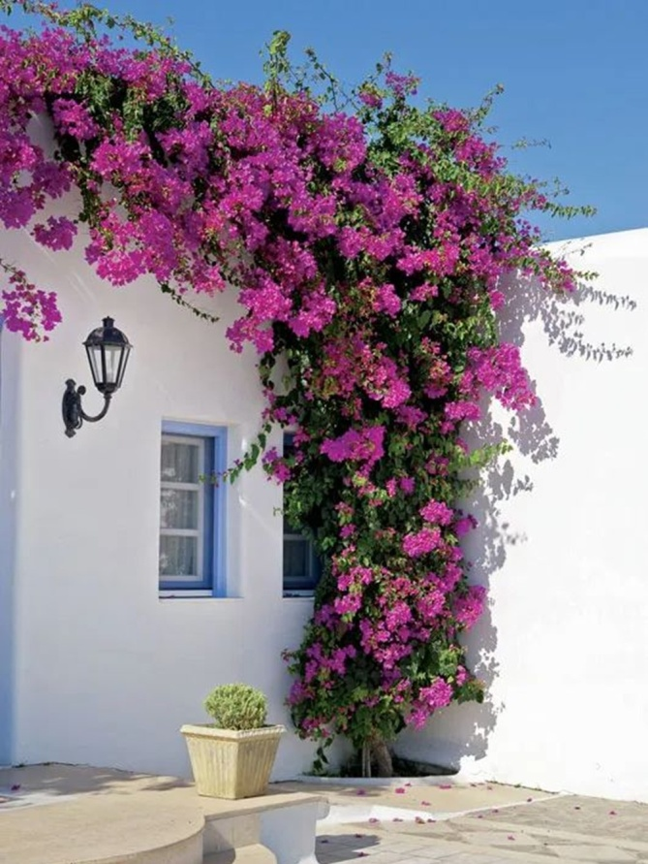
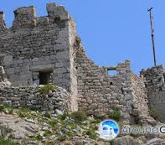
Tilos
bougainvillea

Slide 11
Watch the video
Read the text
Tilos a dreamland for refugees

Slide 12
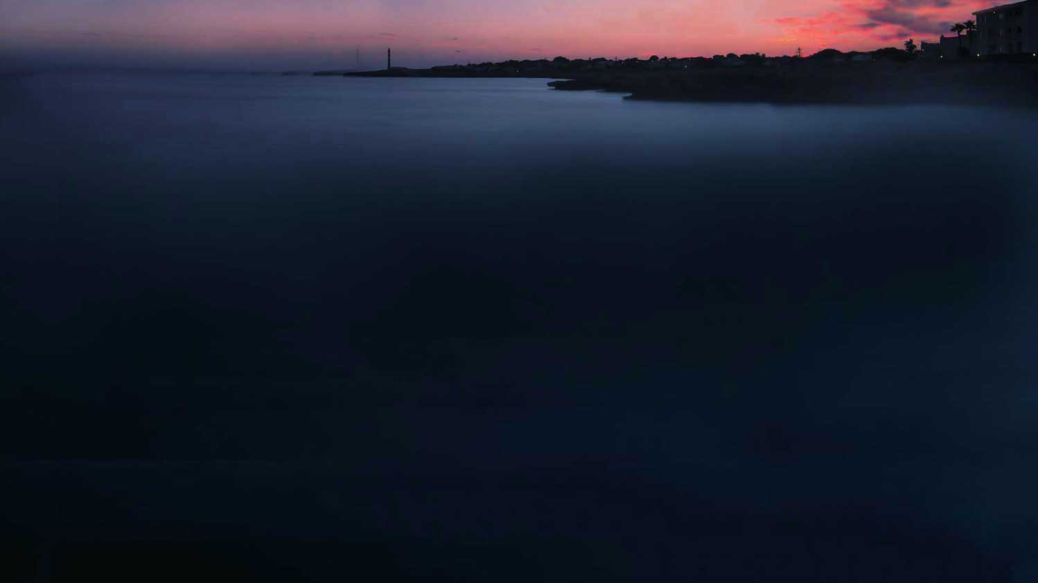
Column
Infographic
Group 1 :
Group 3
On Tilos, in contrast, the children go to Greek and English lessons and will start attending schools on the island in September………
The kids go to the playground in the village, they swim in the sea. And they pick up Greek quickly.”
Tucked away in a quiet corner of the Aegean,….
We can solve the refugee problem,” the mayor told The Telegraph.
Group 2:
Maria Kamma, the mayor of Tilos, has welcomed the refugee families. …..
Those asylum seekers, many of them women and small children, are suffering ever greater levels of “psychological stress” and despair, according to the UN.
Group 4
Like many Greek islands, Tilos has suffered from chronic depopulation in the past……
“I’d like them to stay. They’re human
beings. It’s their right to live in humane conditions. Tilos is a place where we can support their dreams of a peaceful life,” she said.

Slide 13
THANK YOU

