Slide 1
Let me introduce myself
To know us better

Slide 2
Vicky
My name is

Slide 3
A few things about me

Slide 4
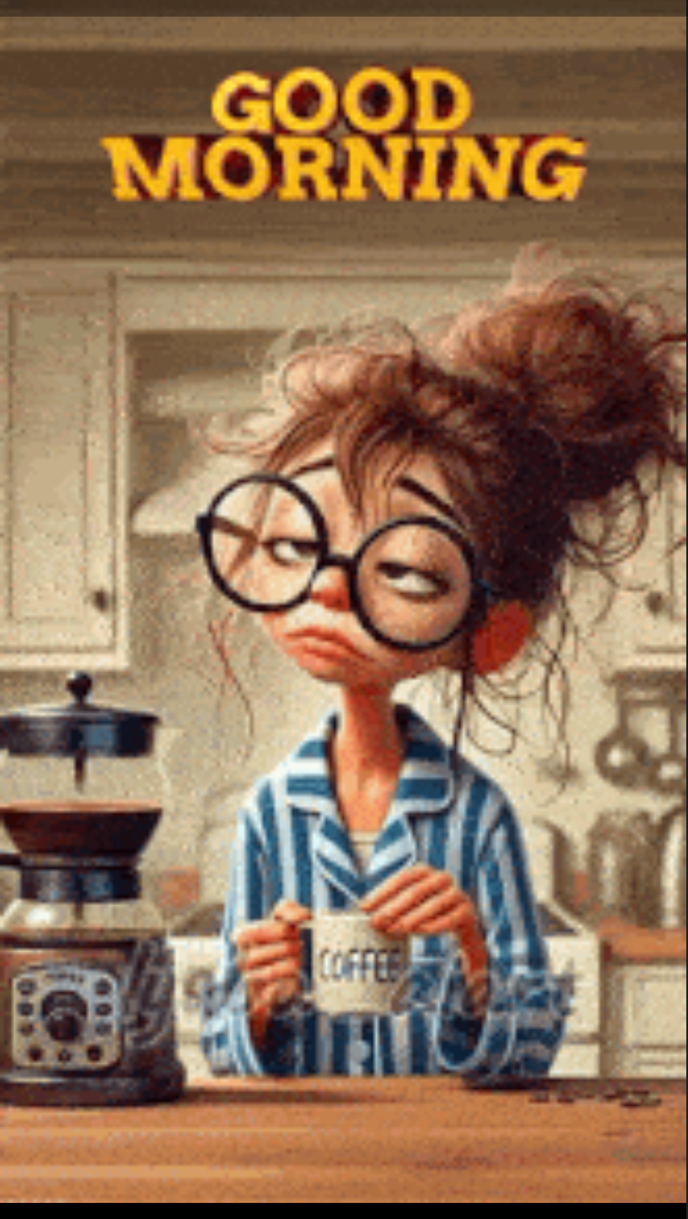
I get up early in the morning

Slide 5
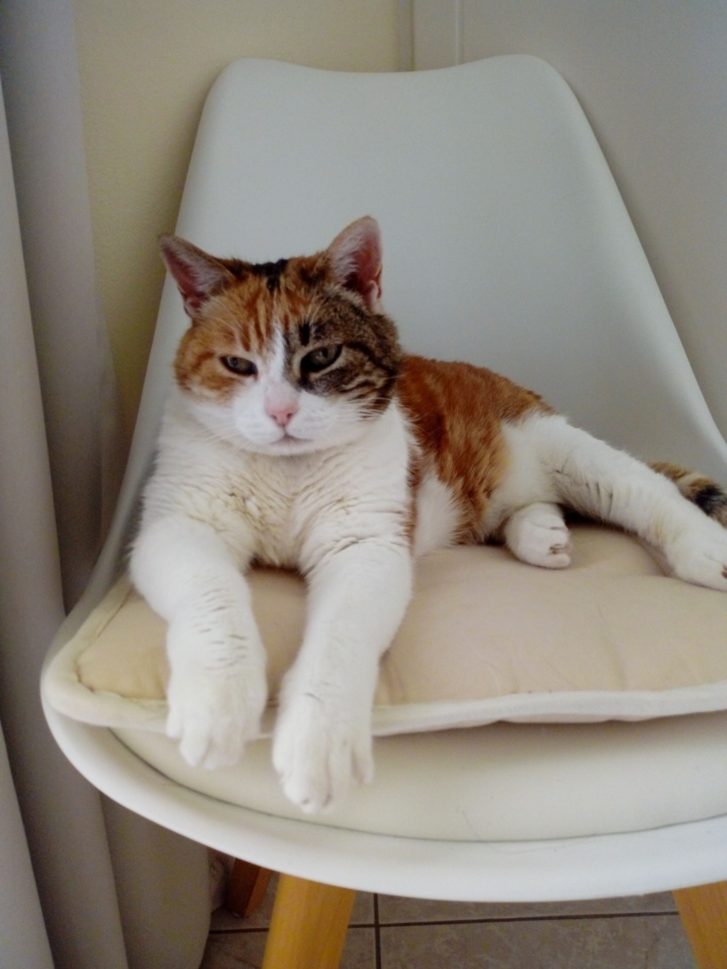
I feed my cat and I get ready for school

Slide 6
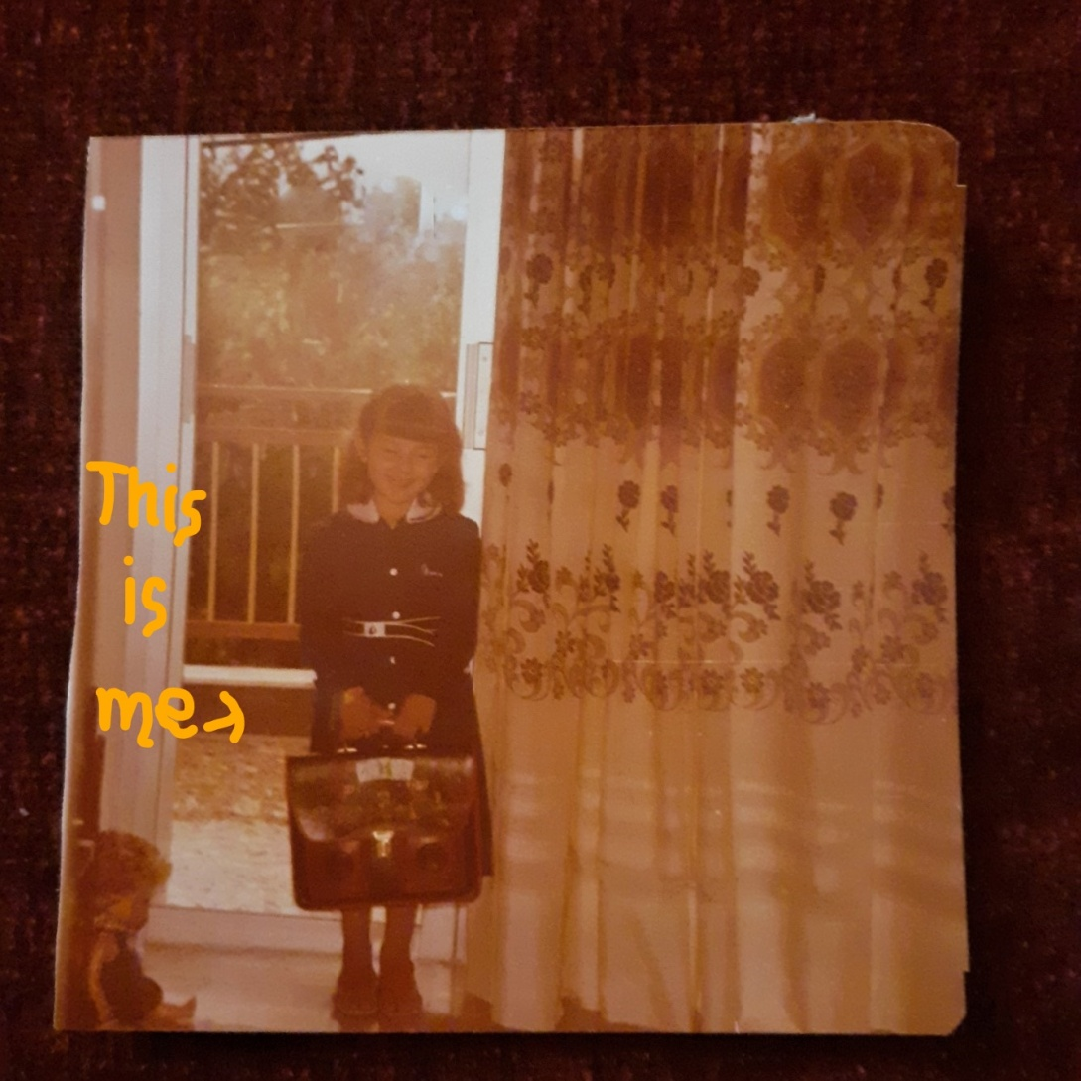
This is me on my 1st Day at school many years ago

Slide 7
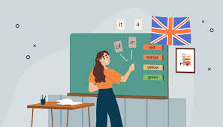
…and I’m still going to school

Slide 8
I have been teaching English for 26 years…

Slide 9
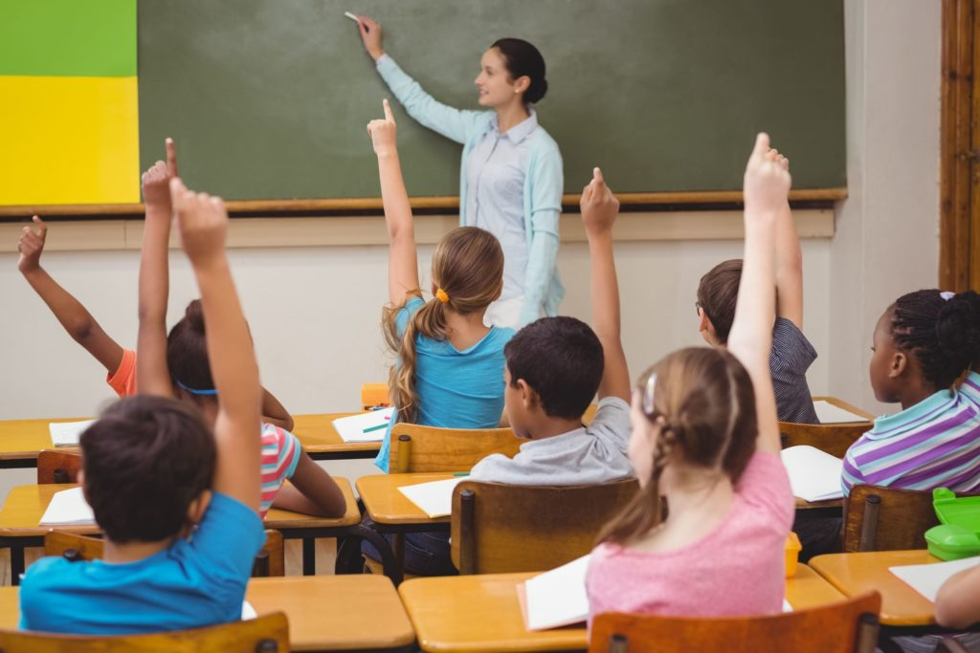
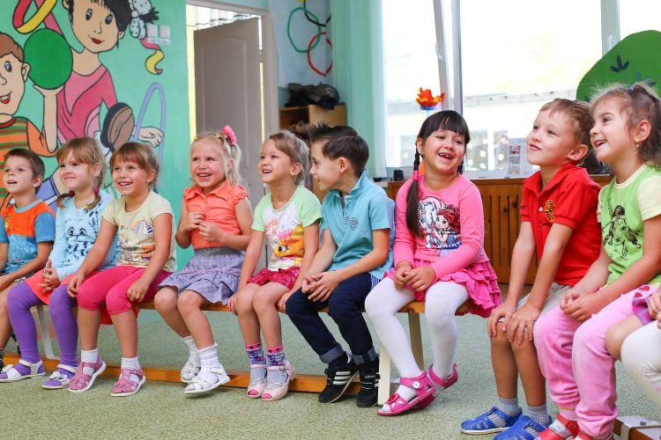
This year I’m teaching English
Kindergarten
2 primary schools

Slide 10
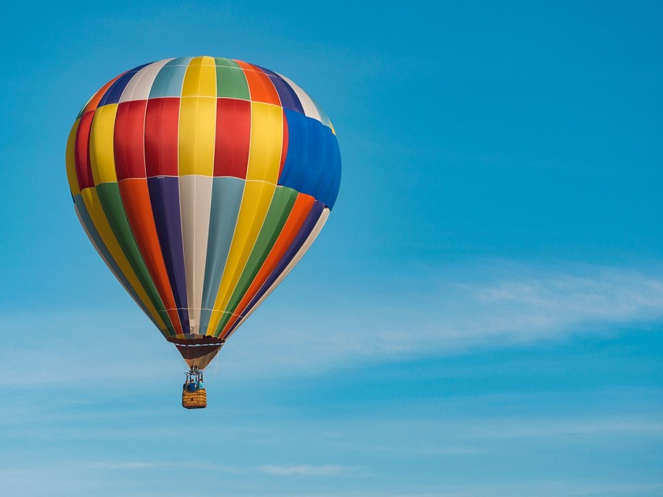
And now here to work with you

Slide 11

I love English

Slide 12
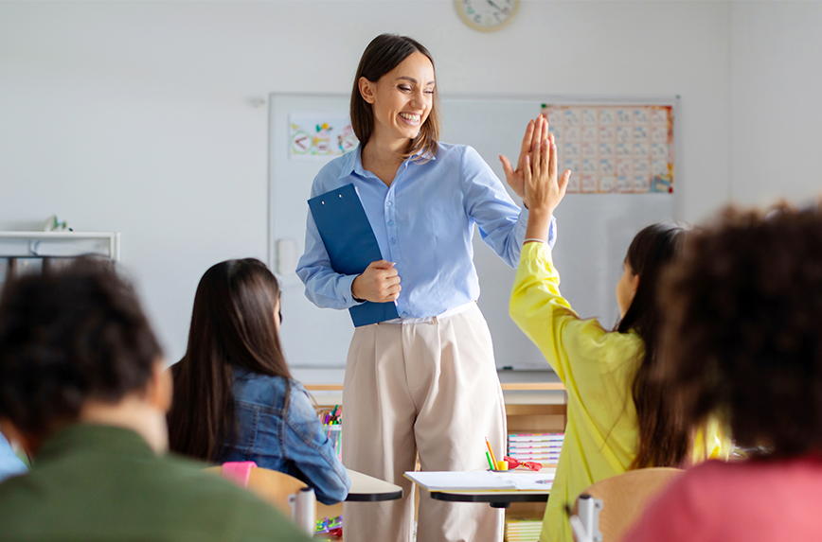
My goal is to have happy students

Slide 13
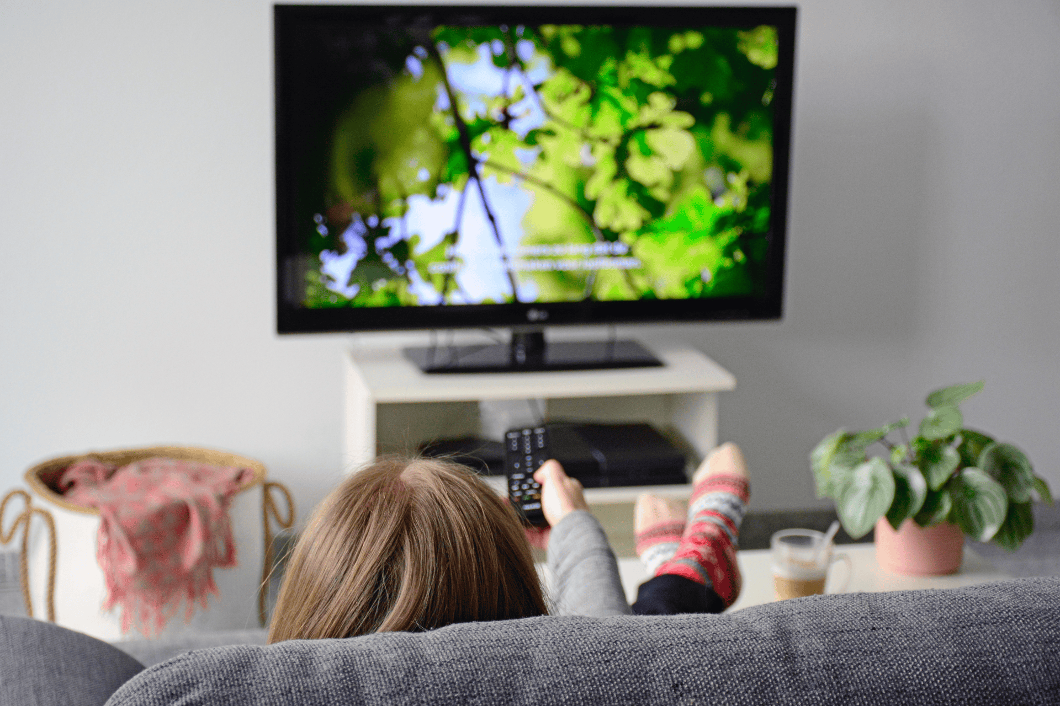
In my free time I like watching TV

Slide 14
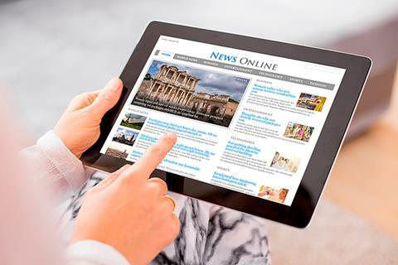
reading articles online

Slide 15
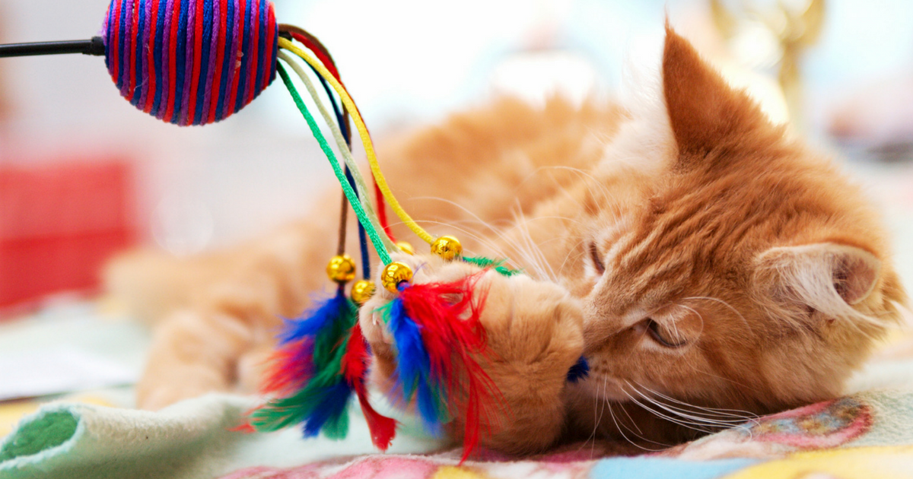
And playing with my cat

Slide 16


My favourite colours are

Slide 17
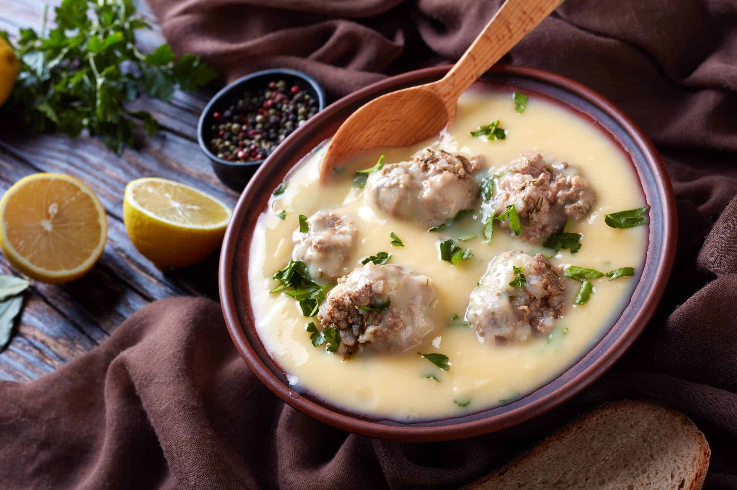
My favourite food is

Slide 18
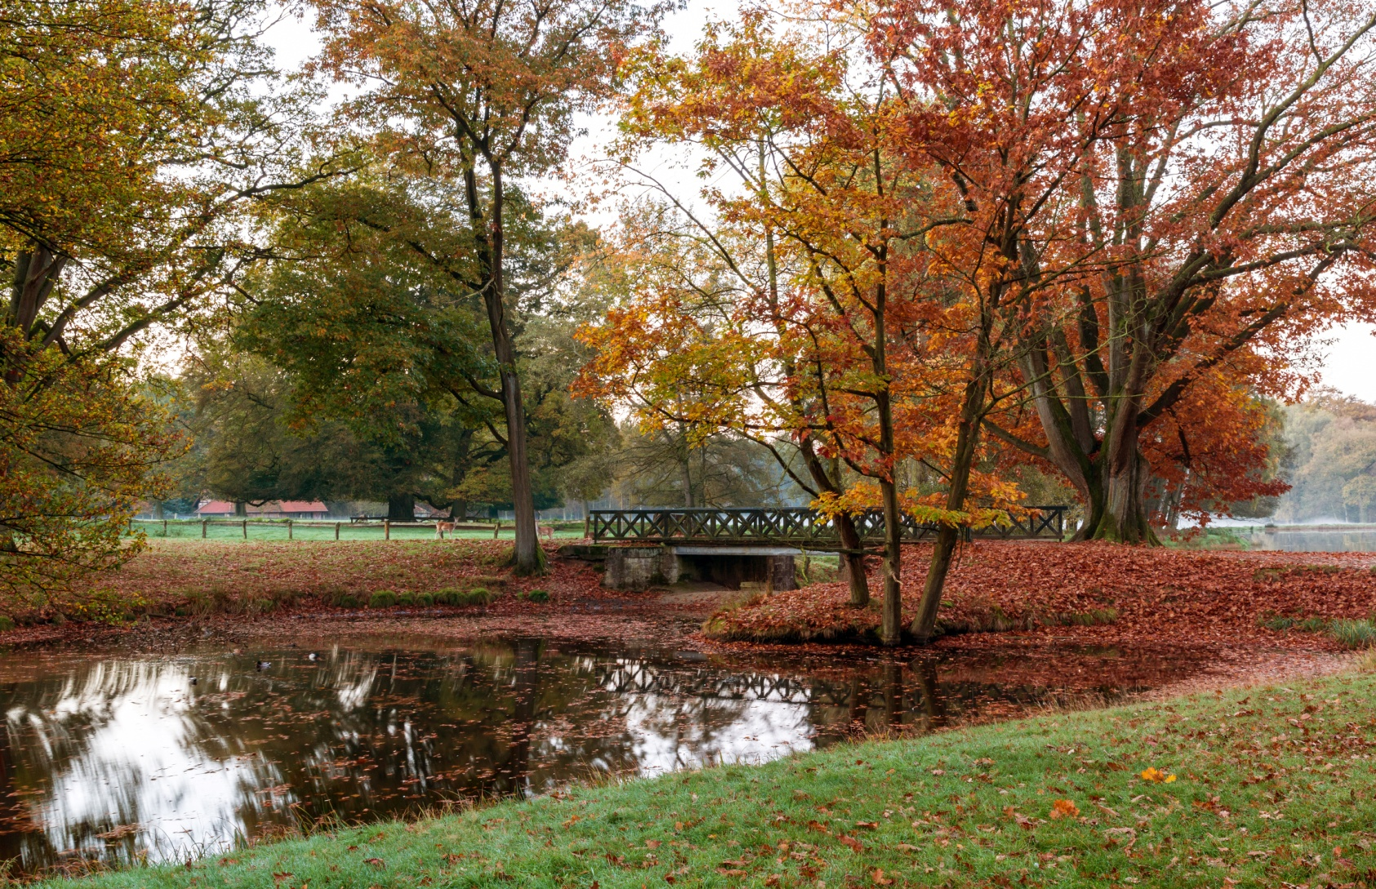
My favourite season is autumn

Slide 19

I use the internet to

Slide 20

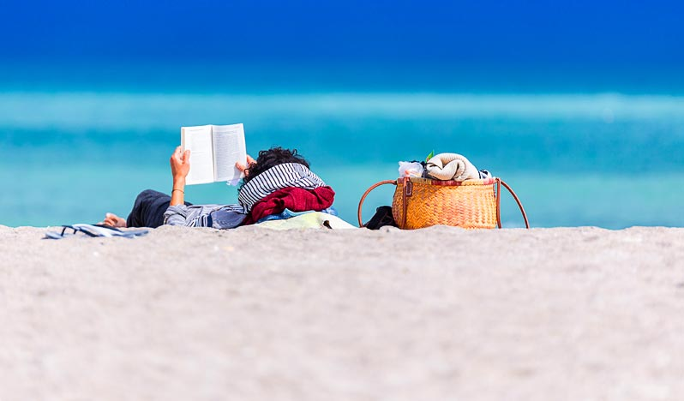
When I finish school I want to go on a long holiday in the sea

Slide 21

Thank you
Now it’s your turn

